Slide 1


Database Technologies - Oracle
A day without new knowledge is a lost day.
the quality of having experience, knowledge, and good judgement; the quality of being wise.
The DIKW pyramid
skills acquired through experience or education
learned about something or someone.
infoway

Slide 2
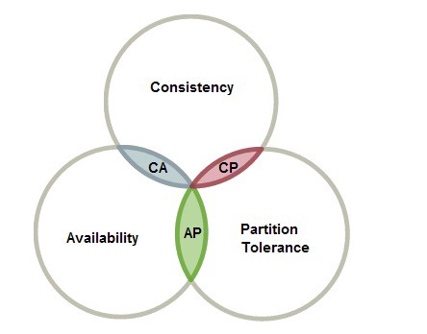
What is CAP Theorem?
CAP theorem states that any database system can only attain two out of following states which is Consistency, Availability and Partition Tolerance.
Consistency: Any changes to a particular record stored in database, in form of inserts, updates or deletes is seen as it is, by other users accessing that record at that particular time.
Availability: The system continues to work and serve data inspite of node failures.
Partition Tolerance: The database system could be stored based on distributed architecture such as Hadoop (HDFS).

Slide 3
Class Room
Session 1

Slide 4
How would you explain a database to a child?

Slide 5

Explain a database in three sentences.
You know, how you have to put your toys away after playing, so you can find them easily the next time you want to play with them?
A database is like a shelf to put your toys away, assume the toys are data instead.
Now, the database can always find the right data easily - whether it's "all the outdated toys" or "all the yellow toys," the computer can get / fetch everything very quickly, as it is stored in database.

Slide 6
ORACLE
ORACLE is the most popular
Relational Database Management System.
Oracle Corporation is an American multinational computer technology corporation headquartered in Redwood Shores, California. The company specializes primarily in developing and marketing database software and technology, cloud engineered systems, and enterprise software products.

Slide 7
What is Relation and Relationship?

Slide 8
What is Relation and Relationship?
Relation ("R"): In Database, a relation represents a table or an entity than contain attributes.
Relationship: In database, relationship is that how the two entities are connected to each other, i.e. what kind of relationship type they hold between them.
Primary/Foreign key is used to specify this relationship.

Slide 9

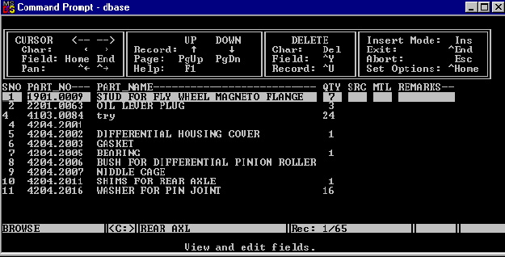

What is a database management system?

Slide 10
What is a database management system?
A database management system (DBMS) is software for creating and managing databases. The DBMS provides users and programmers with a systematic way to create, read, update, and delete data.
DBMS
It supports Single User only
Not Secured
No Relationship (PK/FK)

Slide 11

What is a relational database management system?

Slide 12



relational database management system?
A relational database management system (RDBMS) is a database management system (DBMS) that is based on the relational model.
RDBMS supports
client/server Technology
Highly Secured
Relationship (PK/FK)

Slide 13
properties of relational table
ID | firstName
1 | Saleel Bagde
2 | Sharmin
3 | Vrushali
4 | Ruhan
Relational tables have six properties:
Values are atomic.
Column values are of the same kind.
Each row is unique.
The sequence of columns is insignificant – (unimportant).
The sequence of rows is insignificant – (unimportant).
Each column must have a unique name.

Slide 14
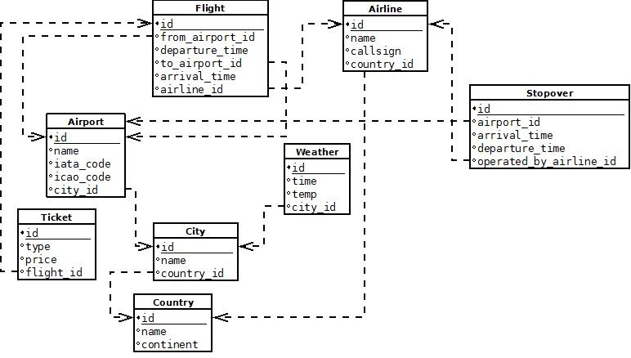

Slide 15

A database application is a computer program whose primary purpose is entering and retrieving information.
What is database?

Slide 16

What is Database?
A database is a system to organize, store and retrieve large amounts of data easily, which is stored in one or more data files by one or more users.
Each database is a collection of tables, which are called relations, hence the name "relational database".
Index Page

Slide 17

What is data?

Slide 18

What is Data?
Data is any facts, number, text, symbol, images, audio, video, or signal that can be recorded and that can be processed by a computer.
Data can be in the form of Text or Multimedia

Slide 19
DBMS and RDBMS

Slide 20
Difference between DBMS and RDBMS?
DBMS | RDBMS
DBMS applications store data as file. | RDBMS applications store data in a tabular form.
Normalization is not present in DBMS. | Normalization is present in RDBMS.
DBMS does not apply any security with regards to data manipulation. | RDBMS defines the integrity constraint for the purpose of ACID (Atomocity, Consistency, Isolation and Durability) property.
DBMS uses file system to store data, so there will be no relation between the tables. | in RDBMS, data are stored in the form of tables, so a relationship between these data will be stored.
DBMS does not support distributed database. | RDBMS supports distributed database.
Examples of DBMS are file systems, xml etc. | Example of RDBMS are mysql, postgre, sql server, oracle etc.

Slide 21
ACID properties of transactions
Atomicity. In a transaction involving two or more separate pieces of information, either all of the pieces are committed or none are.
Consistency. A transaction either creates a new and valid state of data, or, if any failure occurs, returns all data to its state before the transaction was started.
Isolation. A transaction in process and not yet committed must remain isolated from any other transaction.
Durability. Committed data is saved by the system such that, even in the event of a failure and system restart, the data is available in its correct state.

Slide 22
What is Entity Relationship Diagram?

Slide 23
Entity Relationship Diagram (ER Diagram)
Use E-R model to get a high-level graphical view to describe the "ENTITIES" and their "RELATIONSHIP"

Slide 24
Entity Relationship Diagram (ER Diagram)
The basic constructs of ER Model are
Entity, Attributes and Relationships.

Slide 25
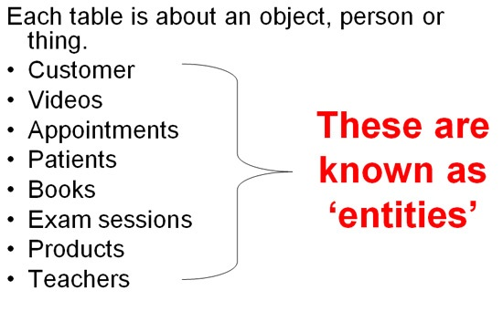
An entity can be a real-world object.
What is Entity?

Slide 26
Entity
In relation to a database , an entity is a person, place, or thing about which data can be stored.
e.g., in a school database, students, teachers, classes, and courses can be considered as entities.
All these entities have some attributes or properties that give them their identity.
Every entity has its own characteristics.

Slide 27
What is Entity Type?

Slide 28
Entity type
The entities that have the common attributes is called an entity type.
Each entity type in the database is described by a name and a list of attributes.
e.g. an entity Person is an entity type that has Age, Name and Address attributes.
Eg.
Entity TYPE Entity
Person (Age, Name, Address ,. . .) 17 , Sharmin, Paud Road, …

Slide 29
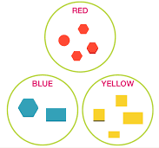
When you are designing attributes for your entities, you will sometimes find that an attribute does not have a value for every instance of the entity. For example, you might want an attribute for a person's middle name, but you can't require a value because some people have no middle name. For these occasions, you can define the attribute so that it can contain null values.
What is an Attribute?
Entity
In some cases, you might not want a specific attribute to contain a null value, but you don't want to require that the user or program always provide a value. In this case, a default value might be appropriate. A default value is a value that applies to an attribute if no other valid value is available.
Attribute

Slide 30
Attributes
A table has rows and columns
In RDBMS, a table organizes data in rows and columns. The COLUMNS are known as ATTRIBUTES / FIELDS whereas the ROWS are known as RECORDS / TUPLE.
In Relation: EMP
Attributes
SSN | EmployeeName | Job | Hiredate | Salary
1 | KING | PRESIDENT | 2017-02-15 | 5000
… | … | … | … | …
… | … | … | … | …
… | … | … | … | …
Rows

Slide 31
Attributes
In Entity Relationship(ER) Model attributes can be classified into the following types.
Simple/Atomic and Composite Attribute
Single Valued and Multi Valued attribute
Stored and Derived Attributes
Complex Attribute

Slide 32
Attributes
Simple / Atomic Attribute --VS-- Composite Attribute
(Can’t be divided further) (Can be divided further)
Single Value Attribute --VS-- Multi Valued Attribute
(Only One value) (Multiple values)
Stored Attribute --VS-- Derived Attribute
(Only One value) (Virtual)
Complex Attribute
(Composite & Multivalued)

Slide 33
Composite VS Multi Valued Attribute

Slide 34

Composite / Multi Valued Attributes
Composite Attribute
Person Entity
Name attribute: FirstName, MiddleName, and LastName
PhoneNumber attribute: CountryCode, CityCode, and PhoneNumber
Multi Valued Attribute
Person Entity
Hobbies attribute: reading, hiking, hockey, skiing, photography.
SpokenLanguages attribute: Hindi, Marathi, Gujarati, English.

Slide 35
What is an Prime, Non-Prime Attribute?

Slide 36
Attributes
Prime attribute
An attribute, which is a part of the prime-key, is known as a prime attribute.
Non-prime attribute
An attribute, which is not a part of the prime-key, is said to be a non-prime attribute.

Slide 37
Entity Relationship Diagram Symbols

Slide 38
Entity Relationship Diagram Symbols
Attribute
Composite Attribute
Key Attribute
Strong Entity
Weak Entity
Derived Attribute
Weak Relationship
Relationship
Multivalued Attribute

Slide 39
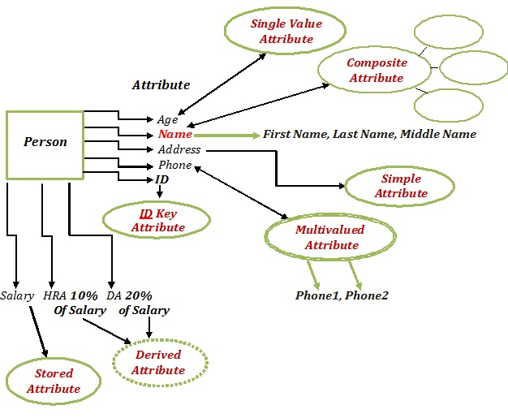
Entity Relationship Diagram

Slide 40
What is a degree, cardinality, domain, and union in database?
Degree d(R): Total no of attributes/columns present in a relation/table is called degree of the relation and is denoted by d(R).
Cardinality |R|: Total no if tuples present in a relation or Rows present in a table, is called cardinality of a relation and is denoted by |R|.
Domain: Total range of accepted values for an attribute of the relation is called the domain of the attribute. (Data Type)
Union Compatibility: Two relations R and S are set to be Union Compatible to each other if and only if:
They have the same degree d(R).
Domains of the respective attributes should also be same.

Slide 41
What is a domain constraint in database?
Domain Constraint = data type + Constraints (NOT NULL / UNIQUE / PRIMARY KEY / FOREIGN KEY / CHECK / DEFAULT)

Slide 42
Data integrity refers to the correctness and completeness of data.
A domain constraint and data integrity?
Domain Constraint = data type + Constraints (NOT NULL / UNIQUE / PRIMARY KEY / FOREIGN KEY / CHECK / DEFAULT)
Data integrity refers to the validity of data, meaning data is consistent and correct. Data integrity is normally enforced in a database by a series of integrity constraints or rules.
Three types of integrity constraints: entity integrity, referential integrity and domain integrity:
Entity integrity concerns the concept of a primary key.
Referential integrity concerns the concept of a foreign key.
Domain integrity A domain is a set of values of the same type.

Slide 43
Common relationships

Slide 44

Relationships - Binary
The three most common relationships in ER models are Binary, Unary, and Ternary
A binary relationship is when two entities participate and is the most common relationship.

Slide 45
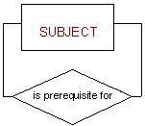
Relationships - Unary
The three most common relationships in ER models are Binary, Unary, and Ternary
A unary relationship is when both participants in the relationship are the same entity.

Slide 46
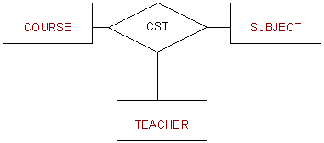
Relationships - Ternary
The three most common relationships in ER models are Binary, Unary, and Ternary
A ternary relationship is when three entities participate in the relationship.

Slide 47

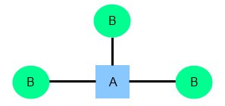
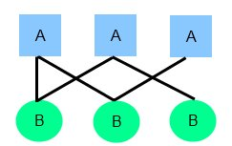
Relationships
There are three degrees of relationship
one-to-one (1:1)
one-to-many (1:M)
many-to-many (M:N)

Slide 48
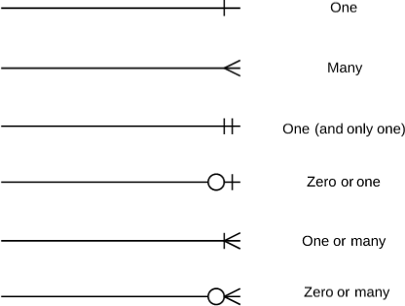
Relationships

Slide 49
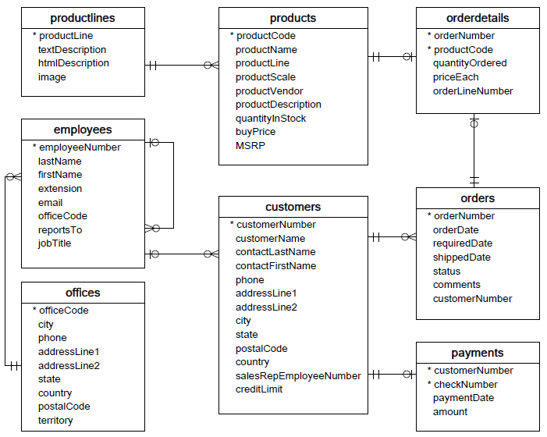

Slide 50
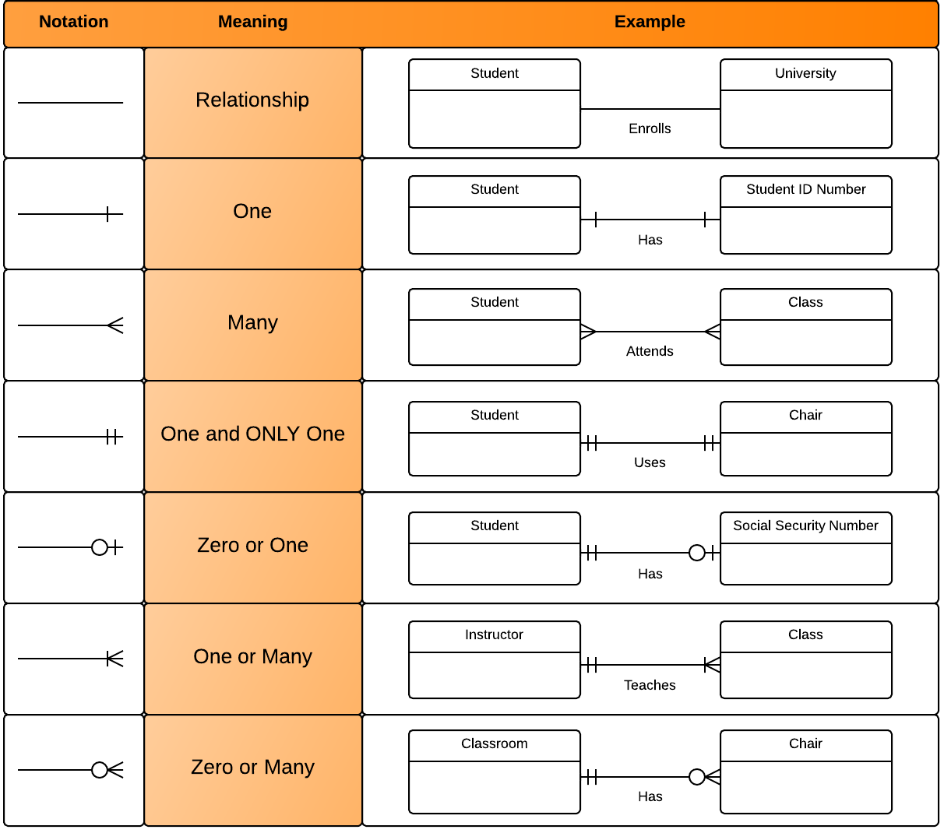
Relationships

Slide 51



one to one Relationships
The employee can manage only one department, and each department can be managed by one employee only.
personID
Name
DOB Gender
Nationality
passportID
personID (not null, unique, and foreign key)
passportNumber issueDate
expireDate

Slide 52

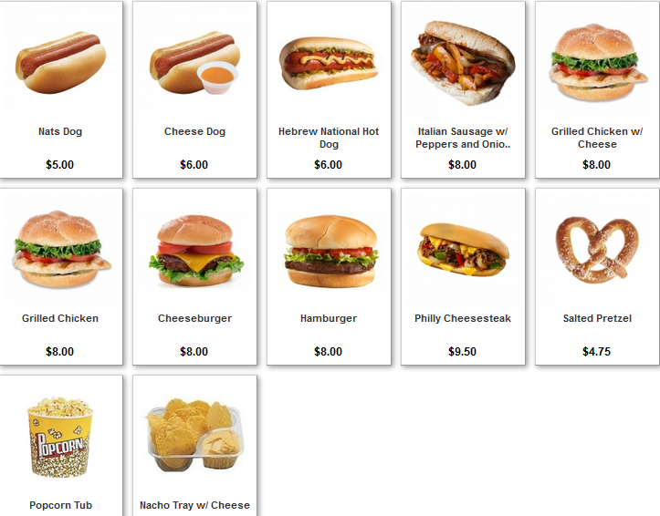
one to many Relationships
The customer may place many orders, but each order can be placed by one customer only.
personID
Name
DOB Gender
Nationality
orderID
personID (foreign key)
Name
Qty
OrderDate

Slide 53

many to one Relationships
The department may have many employees, but each employee can work only in one department.

Slide 54



many to many Relationships
One student may belong to more than one student organizations, and one organization can admit more than one student.

Slide 55
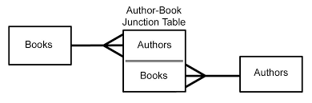
many to many Relationships

Slide 56
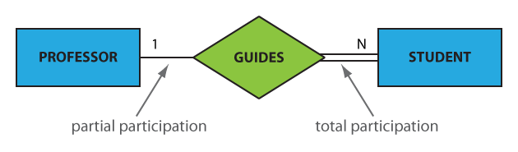
Participation constraints
An entity may participate in a relation either totally or partially.
Total participation means that every entity is involved in the relationship, e.g., each student must be guided by a professor (there are no students who are not guided by any professor. This kind of relation is represented as a double line.
Partial participation means that not all entities are involved in the relationship, e.g., not every professor guides a student (there are professors who don’t). A partial participation is represented by a single line.

Slide 57
What is Data Modeling?

Slide 58
Data Modeling
Data modeling is a process used to define and analyze data requirements needed to support the business processes within the scope of corresponding systems in organizations.
Data modeling involves a progression from conceptual model to logical model to physical object.

Slide 59
What is Schema?

Slide 60
What is Schema?
A schema is a collection of database objects associated with one particular database username. This username is called the schema owner, or the owner of the related group of objects. You may have one or multiple schemas in a database.

Slide 61
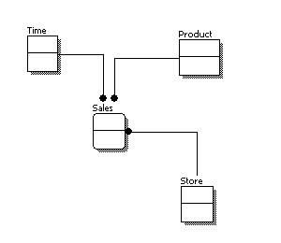
Conceptual Model Design
Features of conceptual data model include:
Includes the important entities and the relationships among them.
No attribute is specified.
No primary key is specified.

Slide 62
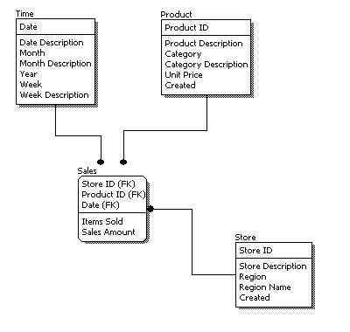
Logical Model Design
Features of logical data model include:
Includes all entities and relationships among them.
All attributes for each entity are specified.
The primary key for each entity is specified.
Foreign keys are specified.

Slide 63
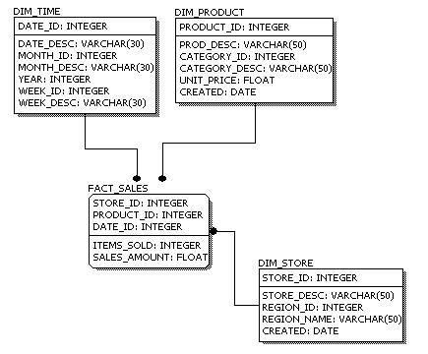
Physical Model Design
Features of physical data model include:
Convert entities into tables.
Convert relationships into foreign keys.
Convert attributes into columns.

Slide 64
Data Modeling
Feature | Conceptual | Logical | Physical
Entity Names | ✓ | ✓
Entity Relationships | ✓ | ✓
Attributes |  | ✓
Primary Keys |  | ✓ | ✓
Foreign Keys |  | ✓ | ✓
Table Names |  |  | ✓
Column Names |  |  | ✓
Column Data Types |  |  | ✓

Slide 65
Branch { branch-ID, branch-name, branch-city, assets }
Customer { customer-id, customer-name, customer-street, customer-only }
Account { account-number, branch-ID, balance }
Loan { loan-number, branch-ID, amount }
Depositor { customer-id, account-number }
Borrower { customer-id, loan-number }
Relational Algebra
∧ (and), ∨ (or), ¬ (not)

Slide 66
Relational Algebra
Select (sigma)
Project (pi)
Union
Set different
Cartesian product
Rename
(σ)
(∏)
(∪)
(−)
(Χ)
(ρ)

Slide 67
SELECT
(σ)
Select
Notation − σ_{p}(r)
σ_{condition}(r)
σ would represent the SELECT command
_{p} would represent the condition for selection.
(r) would represent the Relation or the Table from which we are making a selection of the tuples.
Select the EMPLOYEE whose employee number is 7, or those whose date of birth is ‘01-Jan-1980’
(r)=σ_{empno=7}(EMPLOYEE)
(r)=σ_{dob<=’01-Jan-1980′}(EMPLOYEE)
(r)=σ_{empno=7 ∨ dob=’01-Jan-1980′}(EMPLOYEE)
Returns the result to new relation.

Slide 68
SELECT
(σ)
Select
Notation − σ_{p}(r)
σ_{condition}(r)
Select the EMPLOYEE tuples whose employee number is > 7 and department ID is 10
(r)=σ_{deptno=10} [σ_{empno>7}(EMPLOYEE)]
(r)=σ_{empno>7 ^ deptno=10}(EMPLOYEE)

Slide 69
PROJECT
Project
(∏)
Notation − ∏_{A1, A2, An} (r)
∏_{<attribute-list>}(r)
∏ would represent the ROJECT.
<attribute list> would represent the attributes(columns) we want from a relational.
(r) would represent the Relation or the Table from which we are making a selection of the tuples.
Select Date of Birth (dob) and Employee Number (empno) from the relation EMPLOYE or Select Date of Birth (dob) and Employee Number (empno) from the relation EMPLOYE whose date of birth is before 1980
(r)=∏_{dob, empno}(EMPLOYEE)
(r)=∏_{dob, empno} [σ_{dob<’01-Jan-1980′}(EMPLOYEE)]

Slide 70
UNION
Union
(∪)
Notation − r U s
∏_{<attribute-list>}(r) U ∏_{<attribute-list>}(S)
r, and s must have the same number of attributes.
Attribute domains must be compatible.
Duplicate tuples are automatically eliminated.
Selects the customer name who have either purchased a book or a computer or both.
(r)=∏ _{cName} (BOOK) ∪ ∏ _{cName} (COMPUTER)

Slide 71
INTERSECTION
Intersection
Notation − r ∩ s
(∩)
∏_{<attribute-list>}(r) ∩ ∏_{<attribute-list>}(S)
r, and s must have the same number of attributes.
Attribute domains must be compatible.
Duplicate tuples are automatically eliminated.
Projects the customer name who have purchased a book and a computer both.
(r)=∏ _{cName} (BOOK) ∩ ∏ _{cName} (COMPUTER)

Slide 72
MINUS
(-)
Minus
Notation − r - s
∏_{<attribute-list>}(r) - ∏_{<attribute-list>}(S)
r, and s must have the same number of attributes.
Attribute domains must be compatible.
Duplicate tuples are automatically eliminated.
Projects the customer name who have purchased a BOOK but not a COMPUTER.
Projects the customer name who have purchased a COMPUTER but not a BOOK.
(r)=∏ _{cName} (BOOK) - ∏ _{cName} (COMPUTER)
(r)=∏ _{cName} (COMPUTER) - ∏ _{cName} (BOOK)

Slide 73
CARTESIAN PRODUCT
Cartesian product
(Χ)
Notation − r Χ s
∏_{<attribute-list>}(r) X ∏_{<attribute-list>}(S)

Slide 74
Examples Queries
Find all loans of over $1200
(r)=_{amount > 1200} (loan)
Find the loan number for each loan of an amount greater than $120
(r)=_{loan-number} (_{amount} _{> 1200} (loan))

Slide 75
Examples Queries
Find the names of all customers who have a loan, an account, or both, from the bank
_{customer-name} (borrower)  _{customer-name} (depositor)
Find the names of all customers who have a loan and an
account at bank.
_{customer-name} (borrower)  _{customer-name} (depositor)

Slide 76
Closure of Attributes

Slide 77
Closure of attributes
R (A B C D E F)
Relation
Attributes

Slide 78
A NULL value is not treated as a blank or 0.
The number of attributes in relation is called as its Degree.
SQL Structured Query Language

Slide 79
What is SQL?
SQL Structured Query Language is a database language designed and developed for managing data in relational database management systems (RDBMS). SQL is common language for all Relational Databases.

Slide 80
client configuration parameters

Slide 81
client configuration parameters
Service Name (orcl)
Host Name (Server Name / IP address)
Protocol (TCP/IP) (Transmission Control Protocol / Internet Protocol)
Port (1521) - Port number is the gateway from where the data is send or received.
Physical ports allow connecting cables to computers, routers, modems and other peripheral devices.
Virtual ports are part of TCP/IP networking. These ports allow software applications to share hardware resources.

Slide 82
types of commands

Slide 83
command types
System Variable Commands (Sets a system variable to alter the SQL*Plus environment settings for your current session.)
SQL+ Commands
SQL Commands
PL/SQL Commands

Slide 84
types of object

Slide 85
object types
Table Object
View Object
Synonym Object
Sequence Object
Index Object
Type Object
User Object
Java Object
Procedure Object
Function Object
Trigger Object
Package Object

Slide 86
comments

Slide 87
comments
Begin the comment with -- (two hyphens). Proceed with the text of the comment. This text cannot extend to a new line.
Begin the comment with a slash and an asterisk (/*). Proceed with the text of the comment. This text can span multiple lines. End the comment with an asterisk and a slash (*/).
select * /* This is the test by saleel */ from emp;
select * from emp -- This is the test by saleel;
select * /* This is the test */ from emp --by saleel;
select * / * This is the test * / from emp; // error

Slide 88
login

Slide 89
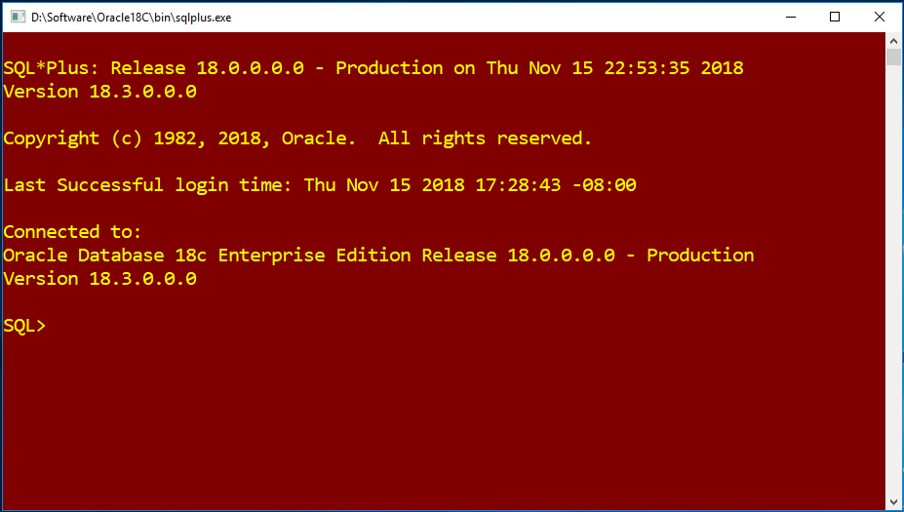
login
default port is 1521
C:\> sqlplus
C:\> sqlplus c##saleel
C:\> sqlplus c##saleel/saleel@orcl




Slide 90
describe
Lists the column definitions for the specified table, view, type or synonym, or the specifications for the specified function, procedure or package.

Slide 91
describe
DESC[RIBE] {[schema.]object[@db_link]}
desc emp

Slide 92
Sets a system variable to alter the SQL*Plus environment settings for your current session.
Shows the value of a SQL*Plus system variable or the current SQL*Plus environment.
set and show

Slide 93
SET and SHOW Syntax
To format the DESCRIBE output use the SET command.
To display the settings for the object, use the SHOW command.
SET system_variable value
SHO[W] option
SHOW ALL/DESCRIBE
SET DESCRIBE DEPTH 2 LINENUM OFF INDENT ON

Slide 94
select statement…

Slide 95
SELECT CLAUSE
The SELECT statement retrieves or extracts data from tables in the database.
You can use one or more tables separated by comma to include various conditions using a WHERE clause, but WHERE clause is an optional part of SELECT command.
You can fetch one or more fields in a single SELECT command.
You can specify star (*) in place of fields. In this case, SELECT will return all the fields.
You can specify any condition using WHERE clause..

Slide 96
Capabilities of SELECT Statement
SELECTION
PROJECTION
JOINING

Slide 97
Capabilities of SELECT Statement
SELECTION
Selection capability in SQL is to choose the rows in a table that you want to return by a query.
EMPNO | ENAME | JOB | HIREDATE
1 | Saleel | Manager | 01-Jan-95
2 | Janhavi | Sales | 20-Dec-94
3 | Snehal | Manager | 21-May-97
4 | Rahul | Account | 30-Jul-97
5 | Ketan | Sales | 01-Jan-94

Slide 98
Capabilities of SELECT Statement
PROJECTION
Projection capability in SQL to choose the columns in a table that you want to return by your query.
EMPNO | ENAME | JOB | HIREDATE
1 | Saleel | Manager | 01-Jan-95
2 | Janhavi | Sales | 20-Dec-94
3 | Snehal | Manager | 21-May-97
4 | Rahul | Account | 30-Jul-97
5 | Ketan | Sales | 01-Jan-94

Slide 99
Capabilities of SELECT Statement
JOINING
Join capability in SQL to bring together data that is stored in different tables by creating a link between them.
EMPNO | ENAME | JOB | HIREDATE | DEPTNO
1 | Saleel | Manager | 01-Jan-95 | 20
2 | Janhavi | Sales | 20-Dec-94 | 10
3 | Snehal | Manager | 21-May-97 | 10
4 | Rahul | Account | 30-Jul-97 | 20
5 | Ketan | Sales | 01-Jan-94 | 30
DEPTNO | DNAME | LOC
10 | HRD | PUNE
20 | SALES | BARODA

Slide 100
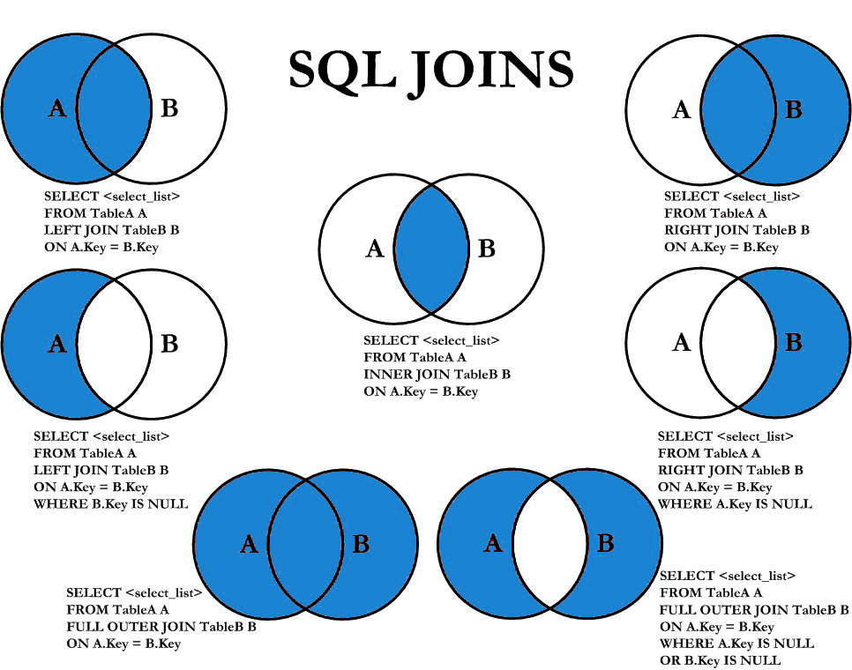

Slide 101
SELECT statement
Specify the all-column wildcard (asterisk) to select all columns, excluding pseudocolumn, from all tables, views, or materialized views listed in the FROM clause.
SELECTION Process
SELECT * FROM <table_references>
Selection-List

Slide 102
SELECT statement
The columns are returned in the order indicated by the COLUMN_ID column of the *_TAB_COLUMNS data dictionary view for the table, view, or materialized view.
PROJECTION Process
SELECT column-list FROM <table_references>
Selection-List

Slide 103
In the select list of a query, a quoted column alias can be specified using string quoting (" ") characters.
column - ALIAS

Slide 104
alias
A programmer can use an alias to temporarily assign another name to a table or column for the duration of a SELECT query. Assigning an alias does not actually rename the column or table.
The AS keyword is optional when aliasing a select_expr with an identifier.
Standard SQL allows references to column aliases in an ORDER BY clause.
Standard SQL allows references to column aliases in a WHERE, if it is the part of subquery.
A table reference can be aliased using tbl_name alias_name
If the column alias contains spaces, put it in quotes (" ").

Slide 105
alias
SQL aliases are used to give a table, or a column in a table, a temporary name.
Column ALIAS
SELECT ColName1 [ [as] alias_name], ColName2 [ [as] alias_name],... ColN from <table_references> [alias_name]
select ename, sal from emp e;
select ename as "First Name", sal "Salary" from emp;
select ename as "First Name", sal "Salary" from emp;

Slide 106
alias
SQL aliases are used to give a table, or a column in a table, a temporary name.
Column ALIAS
You can use the alias in ORDER BY clauses to refer to the column.
SELECT orderNumber "Order no.", SUM(price * quantity) total
FROM orderdetails
ORDER BY "Order no.";

Slide 107
column - expressions

Slide 108
expressions
Column EXPRESSIONS
SELECT ColName1, expressions,... from <table_references>
select 1001 + 1 from dual;
select 1001 + 1 from dual;
select '1' + '1' from dual;
select sal, sal + 1000 as 'New Salary' from emp;
select sal, comm, sal + comm from emp;
select sal, comm, sal + NVL(comm, 0) from emp;

Slide 109
UNIQUE is a synonym for DISTINCT.
distinct / unique
If you use the SELECT DISTINCT or SELECT UNIQUE statement to query data from a column that has many NULL values, the result set will include only one NULL value.

Slide 110
distinct / unique
While DISTINCT is ANSI SQL standard, UNIQUE is an Oracle specific statement. Specify DISTINCT or UNIQUE if you want the database to return only one copy of each set of duplicate rows selected. These two keywords are synonymous.
SELECT [ ALL / DISTINCT / UNIQUE ] * / Col1, Col2, expressions,... from <table_references>
select distinct * from emp;
select distinct job from emp;
select distinct job, deptno from emp;
select sum(distinct sal) from emp;

Slide 111
Defines the substitution character (by default the ampersand "&") and turns substitution on and off.
set verify on/off (will not display old line when we user “&” sign)
substitution variables
You can use substitution variables (pre-processor) anywhere in SQL and SQL*Plus commands.
Both single ampersand (&) and double ampersand (&&) can prefix a substitution variable name in a statement. SQL*Plus pre-processes the statement and substitutes the variable's value. The statement is then executed. If the variable was not previously defined then SQL*Plus prompts you for a value before doing the substitution.

Slide 112
substitution variable - & / &&
TODO
TODO
SELECT [ ALL / DISTINCT / UNIQUE ] * / Col1, Col2, expressions,... from <table_references>
select &var_name1, &var_name2 from emp;
select &&var_name1, &&var_name2 from emp;

Slide 113
row limiting clause

Slide 114
row limit
A Top-N query is used to retrieve the top or bottom N rows from an ordered set.
OFFSET { integer-literal } {ROW | ROWS}
FETCH {FIRST | NEXT} [integer-literal] {ROW | ROWS} {ONLY | WITH TIES }
select * from emp fetch first 5 rows only;
select * from emp offset 5 rows;
select * from emp offset 2 rows fetch first 5 rows only;
select * from emp offset 2 rows fetch first 5 rows with ties;

Slide 115
row limit
A Top-N query is used to retrieve the top or bottom N rows from an ordered set.
OFFSET { integer-literal } {ROW | ROWS}
FETCH {FIRST | NEXT} [integer-literal] {ROW | ROWS} {ONLY | WITH TIES }
define x = 5;
select * from emp fetch first &x rows only;
select * from emp offset (select count(*) from emp) - 5 rows;
select * from emp offset (select count(*) from emp) - 5 rows fetch next 2 rows only;

Slide 116
comparison functions and operator

Slide 117
Comparison Functions and Operator
= | Equal operator
> | Greater than operator
>= | Greater than or equal operator
< | Less than operator
<= | Less than or equal operator
!=, <>, ^> | Not equal operator
between ... and ... | Check whether a value is within a range of values
not between ... and ... | Check whether a value is not within a range of values
in | Check whether a value is not within a set of values
not in | Check whether a value is not within a set of values
like | Simple pattern matching
not like | Negation of simple pattern matching
is null | Test a value against a Boolean
is not null | NOT NULL value test
coalesce() | Return the first non-NULL argument

Slide 118
logical operator

Slide 119
Logical Operator
and | Returns TRUE if both component conditions are TRUE. Returns FALSE if either is FALSE; otherwise returns UNKNOWN.
or | Returns TRUE if either component condition is TRUE. Returns FALSE if both are FALSE. Otherwise, returns UNKNOWN.
not | Returns TRUE if the following condition is FALSE. Returns FALSE if it is TRUE. If it is UNKNOWN, it remains UNKNOWN.

Slide 120

SELECT statement… syntax
SELECT is used to retrieve rows selected from one or more tables, and can include UNION statements and subqueries.

Slide 121
The default sort order is ascending, with smallest values first. To sort in reverse (descending) order, add the DESC keyword to the name of the column you are sorting by.
order by clause
To sort a result, use an ORDER BY clause.
You can sort on multiple columns, and you can sort different columns in different directions.
NULLS LAST is the default for ascending order, and NULLS FIRST is the default for descending order.

Slide 122
order by clause
When doing an ORDER BY, NULL values are presented LAST if you do ORDER BY ... ASC and FIRST if you do ORDER BY ... DESC.
SELECT column-list from <table_references>
[ORDER BY { col_name | expr | position | alias } [ASC | DESC], ...] [ NULLS FIRST | NULLS LAST ]
If SELECT DISTINCT is specified or if the SELECT statement contains a GROUP BY clause, the ORDER BY columns must be in the SELECT list.
If the null ordering is not specified then the handling of the null values is:
NULLS LAST if the sort is ASC
NULLS FIRST if the sort is DESC

Slide 123
order by clause
When doing an ORDER BY, NULL values are presented LAST if you do ORDER BY ... ASC and FIRST if you do ORDER BY ... DESC.
SELECT column-list from <table_references>
[ORDER BY { col_name | expr | position | alias } [ASC | DESC], ...] [ NULLS FIRST | NULLS LAST ]
"Ordered by attributes A1, A2, …"
Tuples are sorted by specified attributes
Results are sorted by A1 first
Within each value of A1, results are sorted by A2

Slide 124
order by clause
When doing an ORDER BY, NULL values are presented LAST if you do ORDER BY ... ASC and FIRST if you do ORDER BY ... DESC.
SELECT column-list from <table_references>
[ORDER BY { col_name | expr | position | alias } [ASC | DESC], ...] [ NULLS FIRST | NULLS LAST ]
select * from emp order by job;
select * from emp order by job desc;
select * from emp order by comm;
select * from emp order by 7;
select * from emp order by 7 nulls last;
select * from emp order by comm nulls last;
select * from emp order by comm desc nulls first;

Slide 125
In WHERE clause operations can be performed using…
CONSTANTS
TABLE columns
FUNCTION calls (PRE-DEFINED / UDF)
where clause
The WHERE Clause is used when you want to retrieve specific information from a table excluding other irrelevant data.
Expressions in WHERE clause can use
Arithmetic operators
Comparison operators
Logical operators

Slide 126
where clause
A WHERE clause is an optional part of a SelectExpression, DELETE statement, or UPDATE statement. The WHERE clause lets you select rows based on a boolean expression. Only rows for which the expression evaluates to TRUE are returned in the result, or, in the case of a DELETE statement, deleted, or, in the case of an UPDATE statement, updated.
SELECT [ ALL / DISTINCT / UNIQUE ] * / Col1, Col2, expressions, ... from <table_references> [ WHERE where_condition ]
select * from emp where deptno = 10;
select * from emp where ename = 'KING';
select * from emp where hiredate = '09-JUN-81';

Slide 127
rownum pseudocolumn

Slide 128
rownum
The ROWNUM pseudocolumn returns a number indicating the order in which Oracle selects the row from a table or set of joined rows. The first row selected has a ROWNUM of 1.
If an ORDER BY clause follows ROWNUM in the same query, then the rows will be reordered by the ORDER BY clause.
rownum
select rownum, emp.* from emp;
select rownum, emp.* from emp order by job;
select rownum, emp.* from emp where rownum < 10 ;

Slide 129
random package

Slide 130
random string
The DBMS_RANDOM package provides a built-in random string generator.
dbms_random.string (option in char, len in number)
'u', 'U' - returning string in uppercase alpha characters
'l', 'L' - returning string in lowercase alpha characters
'a', 'A' - returning string in mixed case alpha characters
'x', 'X' - returning string in uppercase alpha-numeric characters
'p', 'P' - returning string in any printable characters.
select dbms_random.string ('u', 20) from dual;

Slide 131
random number
The DBMS_RANDOM package provides a built-in random number generator.
dbms_random.value()
dbms_random.value(low in number, high in number)
select dbms_random.value () from dual;
select dbms_random.value (1, 100) from dual;

Slide 132
Defines the substitution character (by default the ampersand "&") and turns substitution on and off.
set define #
set define on/off
set verify on/off (will not display old line when we user “&” sign)
define variables
You can use substitution variables anywhere in SQL and SQL*Plus commands.

Slide 133
define & undefine
Specifies a user or predefined variable and assigns a CHAR value to it.
DEF[INE] [variable] | [variable = text]
define dno = 10
define name = KING
define jb = 'MANAGER'
define dt = '23-JAN-82'
select &dno, '&name', '&jb', '&dt' from dual;
Deletes one or more substitution variables that you defined explicitly with the DEFINE command.
UNDEF[INE] variable ...
undefine dno
undefine name jb dt

Slide 134
accept

Slide 135
accept
Reads a line of input and stores it in a given substitution variable.
ACC[EPT] variable [NUM[BER] | CHAR | DATE] [FOR[MAT] format] [DEF[AULT] default] [PROMPT text] [HIDE]
accept pwd CHAR PROMPT 'Password: ' HIDE
accept firstname CHAR FORMAT 'A12' PROMPT 'Enter employee name: '
accept salary NUMBER FORMAT '9999.99' DEFAULT '0000.0' PROMPT 'Enter salary: '
select '&pwd', '&firstname', &salary from dual;

Slide 136
system datetime functions

Slide 137
sysdate
sysdate , systimestamp returns the database's date and timestamp, whereas current_date , current_timestamp returns the date and timestamp of the location from where you work.
select sysdate from dual;
select systimestamp from dual;
select current_date from dual;
select current_timestamp from dual;

Slide 138
+ or – operator with date
Arithmetic operator like ( + or - ) also can be performed with dates.
select sysdate + 1 from dual;
select sysdate - 1 from dual;
select current_date + 1 from dual;
select current_date – 1 from dual;

Slide 139
NLS_DATE_FORMAT specifies the default date format to use with the TO_CHAR and TO_DATE functions. The value of this parameter can be any valid date format mask, and the value must be surrounded by double quotation marks.
NLS_DATE_FORMAT = "format"
nls_date_format format
alter session set nls_date_format = 'dd-mon-yyyy hh:mi:ss';

Slide 140
date and time formats

Slide 141
date and time formats
select to_char (sysdate, 'd') from dual;
D | Numeric day of the week.
DD | Numeric day of the month.
DDD | Numeric day of the year.
Dy | Three-letter abbreviation of the week.
Day | Full name of the day of the week.
fmDay | Formatted Day, which suppresses blank padding, the length of the return value may vary
W | Week of month
WW | Week of year
MM | Two-digit value for the month.

Slide 142
date and time formats
select to_char (sysdate, 'Mon') from dual;
Mon | Three-letter abbreviation of the month.
Month | Full name of the month.
fmMonth | Formatted Month, which suppresses blank padding, the length of the return value may vary
YY | Two-digit value for the year.
YYYY | Full year in numbers.
Year | Year spelled out (in English).
Q | Quarter of year.

Slide 143
date and time formats
select to_char (sysdate, 'HH') from dual;
Th | Ordinal number. Eg 4th
Sp | Spelled-out number.
HH | Hour of the day.
HH12 | Hour of the day (1-12).
HH24 | Hour of the day (0-23).
MI | Minute
SS | Seconds
AM/PM | Meridian indicator

Slide 144
number formats

Slide 145
number formats
select to_char (sal, '9999') from emp;
9 | Represents a number.
0 | Forces a zero to be displayed.
$ | Places a dollar sign.
.(dot) / D | Print a decimal point.
,(comma)/ G | Print a comma as thousands.
C | Currency USD.
S | Returns the negative or positive value
MI | Minus sign to right (negative values
PR | Returns negative value in <angle brackets>.
L | Local currency.

Slide 146
number formats
select to_char (sal, '9999') from emp;
9 | Represents a number.
0 | Forces a zero to be displayed.
$ | Places a dollar sign.
.(dot) / D | Print a decimal point.
,(comma)/ G | Print a comma as thousands.
C | Currency USD.
S | Returns the negative or positive value
MI | Minus sign to right (negative values
PR | Returns negative value in <angle brackets>.
L | Local currency.

Slide 147
NLS_CURRENCY specifies the string to use as the local currency symbol for the L number format element.
NLS_CURRENCY = "currency_symbol"
nls_currency format
alter session set nls_currency = 'Rs.';

Slide 148
string function

Slide 149
string function
select lower (ename) from emp;
lower | LOWER ('string')
upper | UPPER ('string')
initcap | INITCAP ('string')
concat | CONCAT ('string1', 'string2')
substr | SUBSTR ('string', 1,5) SUBSTR ('string',- 5)
length | LENGTH ('string')
coalesce | COALESCE (null,20,30)
instr | INSTR ('string1', 'string2')
lpad | LPAD (salary, 10, '*')
rpad | RPAD (salary, 10, '*')
ascii | ASCII('A')
chr | CHR(65)

Slide 150
string function
select rtrim(ename, 'N') from emp;
rtrim | RTRIM ('string', 'H')
ltrim | LTRIM ('string', 'H')
trim | TRIM (' HelloWorld ')
reverse | REVERSE ('Hello')
replace | REPLACE (ename, 'S', 'x')
translate | TRANSLATE (ename, 'S', 'x')

Slide 151
number function

Slide 152
number function
select abs(-1) from dual;
abs
ceil
floor
greatest
least
mod
round
sqrt
truncate

Slide 153
date function

Slide 154
date function
select months_bwtween('01-sep-95', '11-jan-94') from dual;
months_between | months_between ('01-sep-95', '11-jan-94')
add_months | add_months ('01-sep-95', 6)
next_day | next_day ('01-sep-95', 'Friday')
last_day | last_day ('01-feb-95')

Slide 155
between … and … condition

Slide 156
Check whether a value is within a range of values
between ... and ...
All three expressions: expr, begin_expr, and end_expr must have the same data type.
If any expression is NULL, the BETWEEN operator returns a NULL value.
BETWEEN ... AND ... condition
select * from emp where sal between 1000 and 3000;
select * from emp where sal between null and null;
select * from emp where sal between null and 3000;
select * from emp where ename between 'A' and 'D';
select * from emp where hiredate between '01-JAN-82' and '31-MAR-83';
select * from emp where sal between (select sal from emp where ename = 'JONES') and (select sal from emp where ename = 'KING');

Slide 157
Check whether a value is within a range of values
not between ... and ...
All three expressions: expr, begin_expr, and end_expr must have the same data type.
If any expression is NULL, the BETWEEN operator returns a NULL value.
NOT BETWEEN ... AND ... condition
select * from emp where sal not between 1000 and 3000;
select * from emp where sal not between null and null;
select * from emp where sal not between null and 3000;
select * from emp where ename not between 'A' and 'D';
select * from emp where hiredate not between '01-JAN-82' and '31-MAR-83';
select * from emp where sal not between (select sal from emp where ename = 'JONES') and (select sal from emp where ename = 'KING');

Slide 158
in(…) condition

Slide 159
in condition
The IN operator allows you to specify multiple values in a WHERE clause.
IN condition
Equal-to-any-member-of test. Equivalent to =ANY.
SELECT ColName1, expressions,... from <table_references>
WHERE ColName1 IN (expression_list, subquery)
select * from emp where deptno in (10, 30);
select * from emp where deptno in (10, null);
select * from emp where deptno in (select deptno from emp where ename = 'KING');
select * from emp where deptno in (20, (select deptno from emp where ename = 'KING');

Slide 160
not in condition
The IN operator allows you to specify multiple values in a WHERE clause.
NOT IN condition
Equal-to-any-member-of test. Equivalent to !=ANY.
SELECT ColName1, expressions,... from <table_references>
WHERE ColName1 NOT IN (expression_list, subquery)
select * from emp where deptno not in (10, 30);
select * from emp where deptno not in (10, null);
select * from emp where deptno not in (select deptno from emp where ename = 'KING');
select * from emp where deptno not in (20, (select deptno from emp where ename = 'KING');

Slide 161
like condition
The ESCAPE keyword is used to escape pattern matching characters such as the (%) percentage and underscore (_) if they form part of the data.

Slide 162
like condition
The LIKE conditions specify a test involving pattern matching.
LIKE condition
SELECT ColName1, expressions,... from <table_references>
WHERE ColName1 LIKE 'expression' [ ESCAPE esc_char ]
An underscore ( _ ) in the pattern matches exactly one character in the value.
A percent sign ( % ) in the pattern can match zero or more characters in the value. The pattern '%' cannot match a null.
select * from emp where ename like 'A%';
select * from emp where sal like '2%';
select * from emp where hiredate like '%DEC%';
select * from temp1 where col2 like '%\%%' escape '\';

Slide 163
like condition
The LIKE conditions specify a test involving pattern matching.
LIKE condition
select * from emp where ename like null;
select * from emp where ename like 'null';
select * from emp where ename like '%null%';

Slide 164
not like condition
The LIKE conditions specify a test involving pattern matching.
NOT LIKE condition
SELECT ColName1, expressions,... from <table_references> WHERE ColName1 NOT LIKE 'expression' [ ESCAPE esc_char ]
An underscore ( _ ) in the pattern matches exactly one character in the value.
A percent sign ( % ) in the pattern can match zero or more characters in the value. The pattern '%' cannot match a null.
select * from emp where ename not like 'A%';
select * from emp where sal not like '2%';
select * from emp where hiredate not like '%DEC%';
select * from temp1 where col2 not like '%\%%' escape '\';

Slide 165
If a column in a row has no value, then the column is said to be null, or to contain null. Nulls can appear in columns of any datatype that are not restricted by NOT NULL or PRIMARY KEY integrity constraints.
null in condition
Do not treat empty strings the same as nulls.
Instead of using =, < >, or != to test for equality or inequality with NULL values, use IS NULL or IS NOT NULL

Slide 166
null
The NULL value is special. It means "NO VALUE" or "UNKNOWN VALUE" and cannot be compared to known values the way you compere two known values to each other. If you attempt to use NULL with the usual arithmetic comparison operators, the result is undefined (NULL).
Condition | Evaluation
10 IS NULL | FALSE
10 IS NOT NULL | TRUE
NULL IS NULL | TRUE
NULL IS NOT NULL | FALSE
Condition | Evaluation
10 = NULL | UNKNOWN
10 != NULL | UNKNOWN
NULL = NULL | UNKNOWN
NULL != NULL | UNKNOWN
NULL = 10 | UNKNOWN
NULL != 10 | UNKNOWN

Slide 167
null related functions

Slide 168
nvl
Datatype of both parameters must be same
The NVL function allows you to replace null values with a default value. If the value in the first parameter is null, the function returns the value in the second parameter. If the first parameter is any value other than null, it is returned unchanged.
NVL(expr1, replace_with)
The arguments expr1 and expr2 can have any data type. If their data types are different, then Oracle implicitly converts one to the other. If they cannot be converted implicitly, then will returns an error.
select nvl(null, 'Unknown') as r1 from dual;
select nvl(comm, 0) as r1 from emp;

Slide 169
nvl2
The NVL2 function accepts three parameters. If the first parameter value is not null it returns the value in the second parameter. If the first parameter value is null, it returns the third parameter.
NVL2(expr1, value_if_NOT_null, value_if_null )

Slide 170
nullif
The NULLIF function, it accepts two parameters and returns null if both parameters are equal. If they are not equal, the first parameter value is returned.
NVLIF(expr1, expr2)

Slide 171
coalesce
TODO

Slide 172
schema.table.* | schema.view.* | schema.materialized view.*
identifier qualifiers
The maximum length for each type of identifier like (Table, View, Synonym, Sequence, Index, Type, User, Java, Procedure, Function, Trigger, Package, and Tablespace) is 128 characters

Slide 173
identifier qualifiers
You can refer to a table within the default database as tbl_name.
You can refer to a column as col_name, tbl_name.col_name.
You need not specify a tbl_name prefix for a column reference unless the reference would be ambiguous.
The identifier quote character is the string quoting ( " )

Slide 174
identifier qualifiers
You can refer to a table column using any of the following forms.
Column Reference | Description
col_name | The column col_name from whichever table used in the statement contains a column of that name.
tbl_name.col_name | The column col_name from table tbl_name of the default schema.
schema_name.tbl_name.col_name | The column col_name from table tbl_name of the schema schema_name.
schema.table.* | schema.view.* | schema.materialized view.*
schema.table.col_name | schema.view.col_name | schema.materialized view.col_name
The identifier quote character is the string quoting ( " )

Slide 175
identifier qualifiers
You can refer to a table using any of the following forms.
Table Reference | Description
schema_name.tbl_name | The table tbl_name from whichever table used in the statement to fetch the data.
The identifier quote character is the string quoting ( " )

Slide 176
control flow functions

Slide 177
decode
DECODE compares expr to each search value one by one. If expr is equal to a search, then Oracle Database returns the corresponding result. If no match is found, then Oracle returns default. If default is omitted, then Oracle returns null.
DECODE(expr, search, result
[, search, result ]...
[, default ]
)

Slide 178
case
Returns the result for the first condition that is true. If there was no matching result value, the result after ELSE is returned, or NULL if there is no ELSE part.
CASE selector
WHEN selector_value_1 THEN statements_1
WHEN selector_value_2 THEN statements_2
…
WHEN selector_value_n THEN statements_n
[ ELSE
else_statements ]
END;
select deptno, case deptno when 10 then 'Accounts' else 'N/A' end from emp;

Slide 179
case
Returns the result for the first condition that is true. If there was no matching result value, the result after ELSE is returned, or NULL if there is no ELSE part.
CASE
WHEN condition_1 THEN statements_1
WHEN condition_2 THEN statements_2
...
WHEN condition_n THEN statements_n
[ ELSE
else_statements ]
END;
select deptno, case when deptno = 10 then 'sales' when deptno = 20 then 'purchase' else 'n/a' end r1 from emp;

Slide 180
aggregate functions

Slide 181






Aggregate functions calculate on a group of rows and return a single value for each group. We commonly use the aggregate functions together with the GROUP BY clause. The GROUP BY clause divides the rows into groups and an aggregate function calculates and returns a single result for each group..
// ERROR
The HAVING clause can refer to aggregate functions, which the WHERE clause cannot.

Slide 182
There are 3 places where aggregate functions can appear in a query
in the SELECT-LIST (the items before the FROM clause).
in the ORDER BY clause.
and in the HAVING clause.
"An aggregate may not appear in the WHERE clause unless it is in a subquery contained in a WHERE or HAVING clause or a select list, and the column being aggregated is an outer reference"

Slide 183
sum
This function takes as an argument any numeric data type or any nonnumeric data type that can be implicitly converted to a numeric data type. The function returns the same data type as the numeric data type of the argument.
SUM([ DISTINCT | UNIQUE | ALL ] expr) [ OVER(analytic_clause) ]
DISTINCT (if used outside an aggregation function) that is superfluous.
select sum(sal) from emp;
select sum(all sal) from emp;
select sum(unique sal) from emp;
select sum(distinct sal) from emp;
C1
------
3
-1
select sum(c1) from dual; // 2
select sum(null) from dual; // null
select sum(1) from emp; // 17 rows

Slide 184
avg
This function takes as an argument any numeric data type or any nonnumeric data type that can be implicitly converted to a numeric data type. The function returns the same data type as the numeric data type of the argument.
AVG([ DISTINCT | UNIQUE | ALL ] expr) [ OVER(analytic_clause) ]
DISTINCT (if used outside an aggregation function) that is superfluous.
select avg(sal) from emp;
select avg(all sal) from emp;
select avg(unique sal) from emp;
select avg(distinct sal) from emp;
select avg(null) from dual; // null

Slide 185
min
If there are no matching rows, MIN() returns NULL.
This function takes as an argument any data type. The function returns the same data type as the data type of the argument.
MIN([ DISTINCT | UNIQUE | ALL ] expr) [ OVER(analytic_clause) ]
DISTINCT (if used outside an aggregation function) that is superfluous.
select min(sal) from emp;
select min(job) from emp;
select min(hiredate) from emp;
select min(null) from dual; // null

Slide 186
max
If there are no matching rows, MAX() returns NULL.
This function takes as an argument any data type. The function returns the same data type as the data type of the argument.
MAX([ DISTINCT | UNIQUE | ALL ] expr) [ OVER(analytic_clause) ]
DISTINCT (if used outside an aggregation function) that is superfluous.
select max(sal) from emp;
select max(job) from emp;
select max(hiredate) from emp;
select max(null) from dual; // null

Slide 187
count
If you specify expr, then COUNT returns the number of rows where expr is not null. You can count either all rows, or only distinct values of expr. If you specify the asterisk (*), then this function returns all rows, including duplicates and nulls. COUNT never returns null.
COUNT([ DISTINCT | UNIQUE | ALL ] expr) [ OVER(analytic_clause) ]
DISTINCT (if used outside an aggregation function) that is superfluous.
select count(*) from emp;
select count(1) from emp;
select count(ename) from emp;
select count(comm) from emp;
select count(null) from dual; // 0
select count(emp.*) from emp; // error

Slide 188
group by clause

Slide 189
group by clause
This function's will produce a single value for an entire group or a table.
GROUP BY clause, part of a SelectExpression, groups a result into subsets that have matching values for one or more columns. In each group, no two rows have the same value for the grouping column or columns. NULLs are considered equivalent for grouping purposes.
column-Name must be a column from the current scope of the query; if a GROUP BY clause is in a subquery, it cannot refer to columns in the outer query.

Slide 190
group by clause
This function's will produce a single value for an entire group or a table.
SELECT [ ALL / DISTINCT / UNIQUE ] * / Col1, Col2, expressions, ... from <table_references> [ GROUP BY { col_name } | { ROLLUP | CUBE } (grouping_expression_list) ]
select job from emp group by job;
select job, sum(sal) from emp group by job;

Slide 191
SELECT - GROUP BY
Examples:
SELECT JOB, SAL + 1001 FROM EMP GROUP BY JOB;
SELECT JOB, COUNT(JOB) FROM EMP GROUP BY COUNT(JOB); //error
SELECT JOB, SAL + 1001 FROM EMP GROUP BY SAL + 1001;
SELECT ENAME, LENGTH(ENAME) R1 FROM EMP GROUP BY R1;

Slide 192
SELECT statement… syntax
SELECT is used to retrieve rows selected from one or more tables, and can include UNION statements and subqueries.

Slide 193
SELECT statement
SELECT syntax
UNIQUE is a synonym for DISTINCT.
SELECT [ ALL / DISTINCT / UNIQUE ] * / ColName1, ColName2, expressions,... from <table_references>
[WHERE where_condition]
[GROUP BY {col_name}
[HAVING having_condition]
[ORDER BY {col_name | expr | position} [ASC | DESC], ...] [ NULLS FIRST | NULLS LAST]
The ALL and DISTINCT modifiers specify whether duplicate rows should be returned. ALL (the default) specifies that all matching rows should be returned, including duplicates. DISTINCT specifies removal of duplicate rows from the result set. It is an error to specify both modifiers. UNIQUE is a synonym for DISTINCT.

Slide 194

Standard SQL does not allow you to use an alias in the GROUP BY clause, however, MySQL supports this.
MySQL also allows you to sort the groups in ascending or descending orders while the standard SQL does not.
DISTINCT (if used outside an aggregation function) that is superfluous.
GROUP BY Clause
SELECT id AS 'a', COUNT(*) AS cnt FROM tbl_name GROUP BY `a`;
SELECT id AS 'a', COUNT(*) AS cnt FROM tbl_name GROUP BY 'a';

Slide 195
Standard SQL does not allow you to use an alias in the GROUP BY clause, however, MySQL supports this.
MySQL also allows you to sort the groups in ascending or descending orders while the standard SQL does not.
G_{1,}G_{2,….,}G_{n} ^{G}F₁(A₁), F₂(A₂),…..F_{m}(A_{m}) ^{(r)}
group by clause with distinct
DISTINCT (if used outside an aggregation function) that is superfluous.

Slide 196
SELECT …. For UPDATE

Slide 197
SELECT - for UPDATE
SELECT * FROM EMP for UPDATE;

Slide 198
The HAVING clause is often used with the GROUP BY clause to filter groups based on a specified condition. If the GROUP BY clause is omitted, the HAVING clause behaves like the WHERE clause.
The HAVING clause can refer to aggregate functions, which the WHERE clause cannot.
HAVING Clause

Slide 199
SELECT - HAVING
The MySQL HAVING clause is used in the SELECT statement to specify filter conditions for a group of rows. HAVING clause is often used with the GROUP BY clause. When using with the GROUP BY clause, we can apply a filter condition to the columns that appear in the GROUP BY clause.
If the GROUP BY clause is omitted, the HAVING clause behaves like the WHERE clause.
SELECT column-list from <table_references>
[GROUP BY {col_name | expr | position} [ASC | DESC], ... [WITH ROLLUP]]
[HAVING where_condition]

Slide 200
Difference between WHERE and HAVING clause

Slide 201
WHERE and HAVING clause
WHERE clause can be used with - SELECT, UPDATE, and DELETE statements, where as HAVING clause can only be used with the SELECT statement.
WHERE clause filters rows before aggregation (GROUPING), where as, HAVING clause filters groups, after the aggregations are performed.
Aggregate functions (SUM , MIN, MAX, AVG and COUNT) cannot be used in the WHERE clause, unless it is in a sub query contained in a HAVING clause, whereas, aggregate functions can be used in HAVING clause.

Slide 202
Rownum

Slide 203
Select - Rownum
mysql> SET @ROW = 0;
mysql> SELECT @ROW := @ROW + 1 AS ROWNUM , EMP.* FROM EMP;
mysql> SELECT @ROW := @ROW + 1 AS ROWNUM , EMP.* FROM EMP,
(SELECT @ROW := 0) AS E;
mysql> SELECT @rank := @rank + 1 ,E.* FROM (SELECT JOB, SAL FROM EMP
GROUP BY JOB ORDER BY SAL desc) E , (SELECT @rank := 0) EE;

Slide 204
Questions?

Slide 205
SELECT ... INTO

Slide 206
Select … INTO
The SELECT ... INTO form of SELECT enables a query result to be stored in variables or written to a file.
An INTO clause should not be used in a nested SELECT because such a SELECT must return its result to the outer context.
SELECT ... INTO var_list
SELECT ... INTO OUTFILE
SELECT ... INTO DUMPFILE
Selects column values and stores them into variables.
Writes the selected rows to a file. Column and line terminators can be specified to produce a specific output format.
Writes a single row to a file without any formatting.

Slide 207
SELECT ... INTO var_list

Slide 208
Select … INTO var_list
The SELECT ... INTO form of SELECT enables a query result to be stored in variables or written to a file.
SELECT ... INTO var_list
The selected values are assigned to the variables.
The number of variables must match the number of columns.
The query should return a single row.
If the query returns no rows, a warning with error code 1329 occurs (No data), and the variable values remain unchanged.
If the query returns multiple rows, error 1172 occurs (Result consisted of more than one row).
The statement may retrieve multiple rows, you can use LIMIT 1 to limit the result set to a single row.

Slide 209
Select … INTO var_list
The SELECT ... INTO form of SELECT enables a query result to be stored in variables or written to a file.
SELECT ... INTO var_list
SET @x = 0;
SET @y = null;
SELECT empno, ename into @x, @y from EMP where empno=7788;
SET @x = 0;
SET @y = null;
SELECT max(sal), min(sal) into @x, @y from EMP where empno=7788;

Slide 210
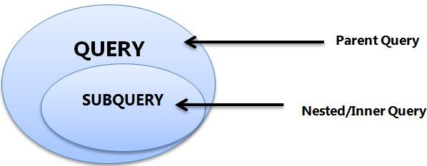
- A subquery must be enclosed in parentheses.
- Use single-row operators with single-row subqueries, and use multiple-row operators with multiple-row subqueries.
- If a subquery (inner query) returns a null value to the outer query, the outer query will not return any rows when using certain comparison operators in a WHERE clause.
Sub-Queries
You may use comparison operators such as <>, <, >, <=, and >= with a single row subquery.
Multiple row subquery returns one or more rows to the outer SQL statement. You may use the IN, ANY, or ALL operator in outer query to handle a subquery that returns multiple rows.

Slide 211
If ORDER BY occurs within a subquery and also is applied in the outer query, the outermost ORDER BY takes precedence.
(SELECT ... ORDER BY a) ORDER BY a DESC;
If LIMIT occurs within a subquery and also is applied in the outer query, the outermost LIMIT takes precedence.
(SELECT ... LIMIT 1) LIMIT 2;
Sub-Queries

Slide 212

Single Row Subqueries
A single row subquery returns zero or one row to the outer SQL statement. You can place a subquery in a WHERE clause, a HAVING clause, or a FROM clause of a SELECT statement.
Outer Query
Subquery or Inner query

Slide 213

Multiple Row and Column Subqueries
A multiple row subquery returns one or more rows to the outer SQL statement. You may use the IN, ANY, or ALL operator in outer query to handle a subquery that returns multiple rows.
Outer Query
Subquery or Inner query

Slide 214
Subqueries
A subquery is a SELECT statement within another statement.
A subquery may occur in:
A SELECT clause
A FROM clause
A WHERE clause
A HAVING clause
A subquery's outer statement can be any one of: SELECT, INSERT, UPDATE, DELETE, SET, or DO.

Slide 215

Subqueries with INSERT
syntax
INSERT INTO table_name [ (column1 [, column2 ]) ]
SELECT [ *|column1 [, column2 ] FROM table1 [, table2 ]
[ WHERE VALUE OPERATOR ];

Slide 216
Subqueries with UPDATE
syntax
UPDATE table_name SET column_name = new_value [ WHERE OPERATOR [ VALUE ] (SELECT column_name FROM table_name) [ WHERE) ]

Slide 217
Subqueries with DELETE
syntax
DELETE FROM table_name [ WHERE OPERATOR [ VALUE ]
(SELECT column_name FROM table_name) [ WHERE) ]

Slide 218
Types of Subqueries
The Subquery as Scalar Operand – SELECT clause
Comparisons using Subqueries – Single row subquery (to give in where or in having clause)
Subqueries in the FROM Clause – Inline Views
Subqueries with ALL, ANY, IN, or SOME – Multiple row subquery (to give in where clause or having clause)
Row Subqueries
Subqueries with EXISTS or NOT EXISTS
Correlated Subqueries

Slide 219
The Subquery as Scalar Operand

Slide 220
The Subquery as Scalar Operand
A scalar subquery is a subquery that returns exactly one column value from one row. A scalar subquery is a simple operand, and you can use it almost anywhere a single column value is legal.
If the subquery returns 0 rows then the value of scalar subquery expression is NULL.
if the subquery returns more than one row then MySQL returns an ERROR.
SELECT (SELECT 1, 2) ; // error
SELECT (SELECT ename, sal FROM EMP); // error
SELECT (SELECT * FROM EMP); // error
SELECT (SELECT NULL + 1);
SELECT ENAME, (SELECT DNAME FROM DEPT WHERE EMP.DEPTNO = DEPT.DEPTNO) R1 FROM EMP ;

Slide 221
Comparisons using Subquery

Slide 222
Comparisons using Subqueries
A subquery can be used before or after any of the comparison operators. The subquery can return at most one value. The value can be the result of an arithmetic expression or a column function. SQL then compares the value with the value on the other side of the comparison operator.
SELECT * FROM EMP where deptno = (SELECT deptno FROM DEPT where deptno in (10, 20));
SELECT * FROM EMP WHERE DEPTNO = (SELECT 5 + 5);
SELECT * FROM EMP WHERE SAL = (SELECT MAX(SAL) FROM EMP);
Comparison Functions and Operators
= | Equal operator
> | Greater than operator
>= | Greater than or equal operator
< | Less than operator
<= | Less than or equal operator
!=, <> | Not equal operator
<=> | NULL-safe equal to operator

Slide 223
Subquery in the FROM Clause

Slide 224
Subqueries in the FROM Clause
Subqueries work in a SELECT statement's FROM clause.
SELECT ... FROM (subquery) [AS] name ...
Every table in a FROM clause must have a name, therefore the [AS] name clause is mandatory.
SET @x :=0;
SELECT * FROM (SELECT @x := @x + 1 as R1, EMP.* FROM EMP) E
WHERE R1 = 5;
SELECT * FROM (SELECT @cnt := @cnt + 1 R1, mod(@cnt,2) R2, EMP.* FROM EMP, (SELECT @cnt:=0) E ) E1 WHERE R2=0;
SELECT MIN(R1) FROM (SELECT COUNT(JOB) R1 FROM EMP GROUP BY JOB) E;

Slide 225
When used with a subquery, the word IN is an alias for = ANY.
NOT IN is not an alias for <> ANY, but for <> ALL.
Subquery with IN, ALL, ANY, or SOME

Slide 226
Subqueries with IN, ALL, ANY, or SOME
operand comparison_operator ANY (subquery)
operand IN (subquery)
operand comparison_operator SOME (subquery)
operand comparison_operator ALL (subquery)
The word SOME is an alias for ANY.
The ANY keyword, which must follow a comparison operator, means return TRUE if the comparison is TRUE for ANY of the values in the column that the subquery returns.
The word ALL, which must follow a comparison operator, means return TRUE if the comparison is TRUE for ALL of the values in the column that the subquery returns.
IN and =ANY are not synonyms when used with an expression list. IN can take an expression list, but = ANY cannot.
SELECT * FROM EMP WHERE DEPTNO IN (5+5, 10+10)
SELECT * FROM EMP WHERE DEPTNO =ANY (10, 20) //error

Slide 227
Subqueries with ANY / SOME
"x = ANY (...)": The value must match one or more values in the list to evaluate to TRUE.
"x != ANY (...)": The value must not match one or more values in the list to evaluate to TRUE.
"x > ANY (...)": The value must be greater than the smallest value in the list to evaluate to TRUE.
"x < ANY (...)": The value must be smaller than the biggest value in the list to evaluate to TRUE.
"x >= ANY (...)": The value must be greater than or equal to the smallest value in the list to evaluate to TRUE.
"x <= ANY (...)": The value must be smaller than or equal to the biggest value in the list to evaluate to TRUE.
The word SOME is an alias for ANY.

Slide 228
Subqueries with ALL
"x = ALL (...)": The value must match all the values in the list to evaluate to TRUE.
"x != ALL (...)": The value must not match any values in the list to evaluate to TRUE.
"x > ALL (...)": The value must be greater than the biggest value in the list to evaluate to TRUE.
"x < ALL (...)": The value must be smaller than the smallest value in the list to evaluate to TRUE.
"x >= ALL (...)": The value must be greater than or equal to the biggest value in the list to evaluate to TRUE.
"x <= ALL (...)": The value must be smaller than or equal to the smallest value in the list to evaluate to TRUE.
empty table
The expression is TRUE, if table T2 is empty.
SELECT * FROM EMP WHERE DEPTNO >ALL (SELECT C1 FROM T2) // This statement will return all rows from EMP table.

Slide 229
Subqueries with IN, ALL, ANY, or SOME
You can use a subquery after a comparison operator, followed by the keyword IN, ALL, ANY, or SOME.
SELECT * FROM EMP WHERE DEPTNO IN (SELECT DEPTNO FROM EMP WHERE DEPTNO = 10 or DEPTNO = 20);
SELECT * FROM EMP WHERE SAL >ALL (SELECT SAL FROM EMP WHERE ENAME = 'ADAMS' or ENAME = 'TURNER');
SELECT * FROM EMP WHERE SAL >ANY (SELECT SAL FROM EMP WHERE ENAME = 'ADAMS' or ENAME = 'TURNER');
SELECT * FROM EMP WHERE SAL >SOME (SELECT SAL FROM EMP WHERE ENAME = 'ADAMS' or ENAME = 'TURNER');

Slide 230
Row Subquery

Slide 231
Row Subqueries
Scalar or column Subqueries return a single value or a column of values. A row subquery is a subquery variant that returns a single row and can thus return more than one column value. You can use = , >, <, >=, <=, <>, !=, <=>
SELECT * from EMP where deptno, 1 = (SELECT deptno, 1 from DEPT where deptno=10);
SELECT * FROM EMP WHERE ROW (DEPTNO, 1) = (SELECT DEPTNO, 1 FROM DEPT WHERE DEPTNO = 10);

Slide 232
Subquery with EXISTS or NOT EXISTS

Slide 233
Subqueries with EXISTS or NOT EXISTS
The EXISTS operator tests for the existence of rows in the results set of the subquery. If a subquery row value is found, EXISTS subquery is TRUE and in this case NOT EXISTS subquery is FALSE.
SELECT * FROM EMP WHERE EXISTS (SELECT * FROM DEPT WHERE EMP.DEPTNO = DEPT.DEPTNO);
SELECT * FROM EMP WHERE NOT EXISTS (SELECT DEPTNO FROM EMP WHERE EMP.DEPTNO = DEPT.DEPTNO);
SELECT * FROM EMP M WHERE EXISTS (SELECT * FROM EMP E WHERE E.MGR = M.EMPNO);
SELECT * FROM EMP M WHERE NOT EXISTS (SELECT * FROM EMP E WHERE E.MGR = M.EMPNO);

Slide 234
Correlated Subquery

Slide 235
Correlated Subqueries
A correlated subquery (also known as a synchronized subquery) is a subquery that uses values from the outer query. The subquery is evaluated once for each row processed by the outer query.
Following query find all employees who earn more than the average salary in their department.
SELECT * FROM EMP E WHERE SAL > (SELECT AVG(SAL) FROM EMP WHERE E.DEPTNO = EMP.DEPTNO) ORDER BY DEPTNO;
SELECT ENAME, SAL, JOB FROM EMP WHERE SAL > (SELECT AVG(SAL) FROM EMP E WHERE E.JOB = EMP.JOB);
SELECT JOB, MAX(SAL) FROM EMP WHERE SAL < (SELECT MAX(SAL) FROM EMP E WHERE EMP.JOB = E.JOB GROUP BY E.JOB) GROUP BY JOB;
SELECT DISTINCTROW DEPTNO FROM EMP WHERE EXISTS (SELECT DEPTNO FROM DEPT WHERE EMP.DEPTNO = DEPT.DEPTNO); (Intersect)
SELECT DISTINCTROW DEPTNO FROM DEPT WHERE NOT EXISTS (SELECT DEPTNO FROM EMP WHERE EMP.DEPTNO = DEPT.DEPTNO);

Slide 236
JOINS

Slide 237
JOINS
JOINS are used to retrieve data from multiple tables.
JOIN is performed whenever two or more tables are joined in a SQL statement.

Slide 238
JOINS
Cartesian or Product Join – Cross Join
Equijoin – Inner Join
Natural Join
Simple Join
Outer Join – Right Outer Join, Left Outer Join
Self Join

Slide 239

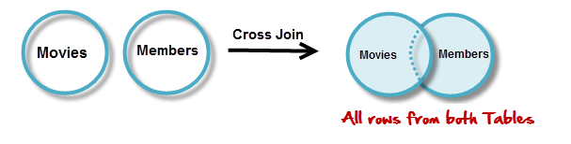

JOINS - Cartesian or Product
Cartesian or Product joins are joins without a join condition. Each row of one table is combined with each row of another table. The result is referred to as a Cartesian product.
SELECT column-list from <table_references>, <table_references>

Slide 240

JOINS – Cross Join
The CROSS JOIN produced a result set which is the product of rows of two associated tables when no WHERE clause is used with CROSS JOIN. In this join, the result set appeared by multiplying each row of the first table with all rows in the second table if no condition introduced with CROSS JOIN.
SELECT column-list from <table_references> CROSS JOIN <table_references>
SELECT * FROM EMP CROSS JOIN DEPT;

Slide 241
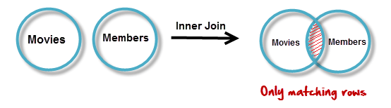

JOINS – equi join
EQUI JOIN performs a JOIN against equality or matching column(s) values of the associated tables. An equal sign (=) is used as comparison operator in the where clause to refer equality.
SELECT column-list from <table_references>, <table_references> WHERE table1.column-name = table2.column-name
SELECT * FROM EMP, DEPT WHERE EMP.DEPTNO = DEPT.DEPTNO
`
JOINING CONDITION

Slide 242
Display how many employees are working from every department?
Display the department name where less the 3 employees are working?

Slide 243
ON Contrition
When this join condition gets applied none of the columns of the relation will get eliminated in the result set.
In order to apply this join condition, on any two tables they need not to have any common column.
ON condition and USING Attribute
USING Attribute Contrition
When all the common columns are used in the join predicate then the result would be same as Natural join.
In the result set of the join the duplicates of the columns used in the predicate gets eliminated.

Slide 244

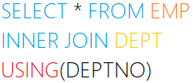
JOINS – USING & ON clause
The ON clause
The ON clause is used to join tables where the column names don’t match in both tables.
JOINING CONDITION
The USING clause
The USING clause is used if several columns share the same name but you don’t want to join using all of these common columns. The columns listed in the USING clause can’t have any qualifiers in the statement.
JOINING CONDITION

Slide 245
JOINS – Inner Join
Inner join returns rows when there is at least one match in both tables.
The INNER JOIN selects all rows from both participating tables as long as there is a match between the columns. An SQL INNER JOIN is same as JOIN clause, combining rows from two or more tables.
SELECT column-list from <table_references> [INNER] JOIN <table_references> ON table1.column-name = table2.column-name
SELECT * FROM EMP INNER JOIN DEPT ON EMP.DEPTNO = DEPT.DEPTNO
SELECT column-list from <table_references> [INNER] JOIN <table_references> USING (column-name)
SELECT * FROM EMP INNER JOIN DEPT USING (DEPTNO)

Slide 246

JOINS – Natural Join
Joins two tables based on common column names. Hence one must confirm the common columns before using a NATURAL JOIN
The NATURAL JOIN is such a join that performs the same task as an INNER JOIN.
SELECT column-list from <table_references> NATURAL JOIN <table_references> NATURAL JOIN <table_references>
SELECT * FROM EMP NATURAL JOIN DEPT
The associated tables have one or more pairs of identically column-names.
The columns must be of the same data type.
Don't use ON / USING clause in a NATURAL JOIN.
When this join condition gets applied always the duplicates of the common columns get eliminated from the result.
A NATURAL JOIN can be used with a LEFT OUTER join, or a RIGHT OUTER join.
If the column-names are not same, then NATURAL JOIN will work as CROSS JOIN.

Slide 247
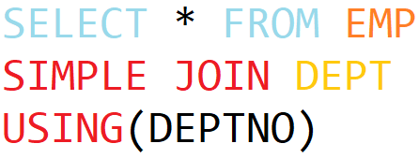
JOINS – Simple Join
The SIMPLE JOIN is such a join that performs the same task as an INNER JOIN.
SELECT column-list from <table_references> SIMPLE JOIN <table_references> USING (column-list)
SELECT * FROM EMP SIMPLE JOIN DEPT USING(DEPTNO)
JOINING CONDITION

Slide 248
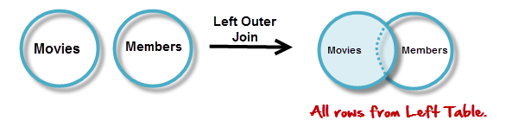
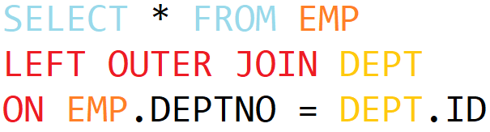

JOINS – Left Outer Join
JOINING CONDITION

Slide 249
JOINS – Left Outer Join
The LEFT JOIN keyword returns all rows from the left table (table1), with the matching rows in the right table (table2). The result is NULL in the right side when there is no match.
SELECT column-list from <table_references> LEFT [OUTER ] JOIN <table_references> ON table1.column-name = table2.column-name
SELECT * FROM EMP LEFT OUTER JOIN DEPT ON EMP.DEPTNO = DEPT.DEPTNO;
SELECT column-list from <table_references> LEFT [OUTER ] JOIN <table_references> USING (column-name)
SELECT * FROM EMP LEFT OUTER JOIN DEPT USING(DEPTNO);
SELECT column-list from <table_references> NATURAL LEFT [OUTER ] JOIN <table_references>
SELECT * FROM EMP NATURAL LEFT OUTER JOIN DEPT;

Slide 250
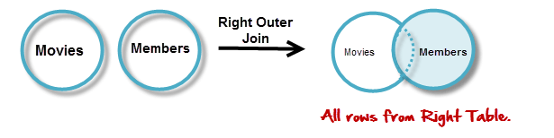

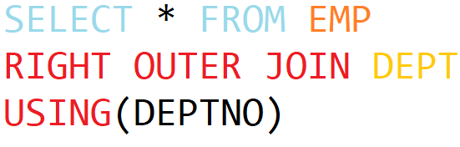
JOINS – Right Outer Join
JOINING CONDITION

Slide 251
JOINS – Right Outer Join
The RIGHT JOIN keyword returns all rows from the right table (table2), with the matching rows in the left table (table1). The result is NULL in the left side when there is no match.
SELECT column-list from <table_references> RIGHT [OUTER ] JOIN <table_references> ON table1.column-name = table2.column-name
SELECT * FROM EMP RIGHT OUTER JOIN DEPT ON EMP.DEPTNO = DEPT.DEPTNO;
SELECT column-list from <table_references> RIGHT [OUTER ] JOIN <table_references> USING (column-name)
SELECT * FROM EMP RIGHT OUTER JOIN DEPT USING(DEPTNO);
SELECT column-list from <table_references> NATURAL RIGHT [OUTER ] JOIN <table_references>
SELECT * FROM EMP NATURAL RIGHT OUTER JOIN DEPT;

Slide 252
JOINS – Self Join
A self join is a join in which a table is joined with itself (which is also called Unary relationships), especially when the table has a FOREIGN KEY which references its own PRIMARY KEY.
SELECT a.column_name, b.column_name... FROM table1 a, table1 b WHERE a.common_name = b.common_name;

Slide 253


UNION: To apply ORDER BY or LIMIT to an individual SELECT, place the clause inside the parentheses that enclose the SELECT.
E.g. (SELECT …) UNION (SELECT …)
Set Operation in SQL

Slide 254
UNION
The UNION operator is used to combine the result sets of 2 or more SELECT statements. It removes duplicate rows between the various SELECT statements. Each SELECT statement within the UNION operator must have the same number of fields in the result sets.
The default behaviour for UNION is that duplicate rows are removed from the result.
SELECT ... UNION [ALL | DISTINCT] SELECT ... [UNION [ALL | DISTINCT] SELECT ...]
SELECT DEPTNO FROM EMP UNION SELECT DEPTNO FROM DEPT;
SELECT DEPTNO FROM EMP UNION ALL SELECT DEPTNO FROM DEPT;
(SELECT DEPTNO FROM EMP LIMIT 1) UNION (SELECT DEPTNO FROM DEPT LIMIT 1);
SELECT 'EMP' as 'Table Name', count(*) FROM EMP UNION SELECT 'DEPT', count(*) FROM DEPT UNION SELECT 'BONUS', count(*) FROM BONUS;

Slide 255
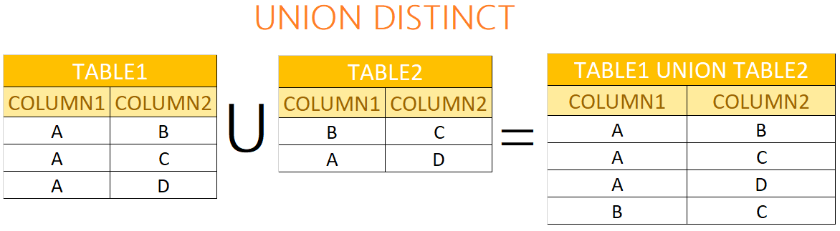
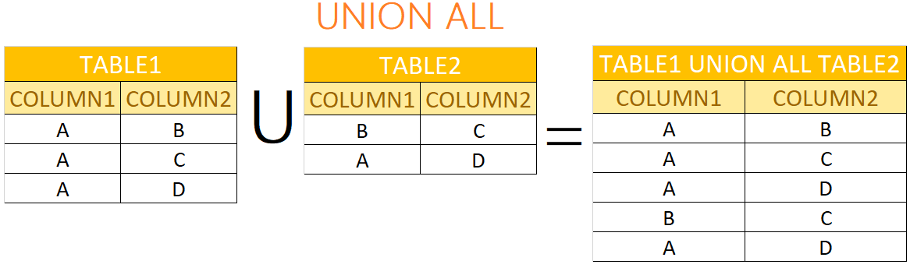
UNION & UNION ALL

Slide 256
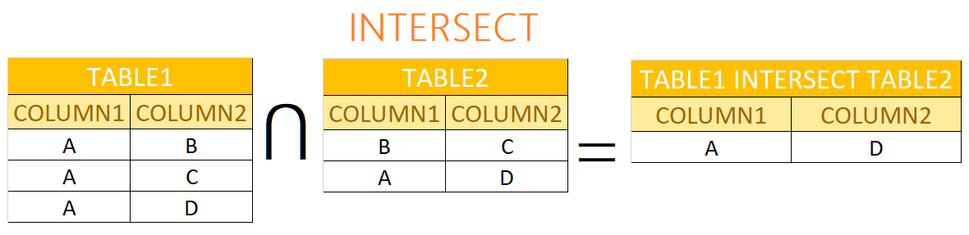
INTERSECT
An INTERSECT query returns the intersection of 2 or more datasets. If a record exists in both data sets, it will be included in the INTERSECT results.
There is no INTERSECT operator in MySQL, you can easily simulate this type of query using either the IN clause or the EXISTS clause.
SELECT * FROM EMP WHERE DEPTNO IN (SELECT DEPTNO FROM DEPT);
SELECT * FROM EMP WHERE EXISTS (SELECT DEPTNO FROM DEPT WHERE EMP.DEPTNO = DEPT.DEPTNO);

Slide 257
MINUS
The MINUS operator takes the distinct rows of one query and returns the rows that do not appear in a second result set.
There is no MINUS operator in MySQL, you can easily simulate this type of query using either the NOT IN clause or the NOT EXISTS clause.
SELECT * FROM DEPT WHERE DEPTNO NOT IN (SELECT DEPTNO FROM EMP);
SELECT * FROM DEPT WHERE NOT EXISTS (SELECT DEPTNO FROM EMP WHERE EMP.DEPTNO = DEPT.DEPTNO);

Slide 258
CREATE TABLE ... LIKE STATEMENT

Slide 259
CREATE TABLE ... LIKE
Use CREATE TABLE ... LIKE to create an empty table based on the definition of another table, including any column attributes and indexes defined in the original table.
CREATE TABLE [IF NOT EXISTS] new_tbl LIKE orig_tbl;
LIKE works only for base tables, not for VIEWS.
You cannot execute CREATE TABLE or CREATE TABLE ... LIKE while a LOCK TABLES statement is in effect.
CREATE TABLE E like EMP;

Slide 260
MEMORY tables are visible to another client, but TEMPORARY tables are not visible to another client.
CREATE TEMPORARY TABLE ... LIKE STATEMENT

Slide 261
CREATE TEMPORARY TABLE ... LIKE
Use CREATE TABLE ... LIKE to create an empty table based on the definition of another table.
CREATE TEMPORARY TABLE [IF NOT EXISTS] new_tbl LIKE orig_tbl;
LIKE works only for base tables, not for VIEWS.
You cannot execute CREATE TABLE or CREATE TABLE ... LIKE while a LOCK TABLES statement is in effect.
You can use the TEMPORARY keyword when creating a table. A TEMPORARY table is visible only to the current session, and is dropped automatically when the session is closed.
CREATE TEMPORARY TABLE E like EMP;
Use TEMPORARY table with the same name as the original can be useful when you want to try some statements that modify the contents of the table, without changing the original table.

Slide 262
CREATE TABLE ... SELECT STATEMENT

Slide 263
CREATE TABLE ... SELECT
You can create one table from another by adding a SELECT statement at the end of the CREATE TABLE statement.
CREATE TABLE new_tbl [AS] SELECT * FROM orig_tbl;
You cannot use FOR UPDATE as part of the SELECT in a statement such as CREATE TABLE new_table SELECT ... FROM old_table .... FOR UPDATE.
If you attempt to do so, the statement fails.
CREATE TABLE E SELECT * FROM EMP;
CREATE TABLE E AS SELECT * FROM EMP;
CREATE TABLE E (ID INT) SELECT * FROM EMP;
CREATE TABLE E AS SELECT 1+1, ENAME FROM EMP;
CREATE TABLE E AS SELECT 1+1 R1, ENAME FROM EMP;
CREATE TABLE E AS SELECT * FROM EMP WHERE 1=2;
By default, this statement does not copy all column attributes such as AUTO_INCREMET

Slide 264
Commit and Rollback

Slide 265
Commit and Rollback
To undo MySQL statements you use the ROLLBACK statement. To write the changes into the database within a transaction, you use the COMMIT statement.
START TRANSACTION
[transaction_characteristic]
transaction_characteristic:
| READ WRITE
| READ ONLY
It is important to note that MySQL automatically commits the changes to the database by default.
START TRANSACTION READ ONLY;
INSERT DEPT values (60, 'HRD', 'Pune' );
COMMIT

Slide 266
Commit and Rollback
To undo MySQL statements you use the ROLLBACK statement. To write the changes into the database within a transaction, you use the COMMIT statement.
BEGIN [WORK]
COMMIT [WORK]
ROLLBACK [WORK]
SET autocommit = {0 | 1}
It is important to note that MySQL automatically commits the changes to the database by default.
BEGIN WORK
INSERT DEPT VALUES (60, 'HRD', 'Pune' );
COMMIT WORK
SET autocommit = {0 | 1} 0 - disable; 1 - enable
SELECT @@AUTOCOMMIT;

Slide 267
Anomalies in DBMS
There are three types of anomalies that occur when the database is not normalized. These are – Insertion, update and deletion anomaly.

Slide 268
Anomalies in DBMS - Example
Suppose a manufacturing company stores the employee details in a table named EMP that has following attributes: ID, FIRSTNAME, ADDRESS, and DEPTNO for storing department details in which the employee works.
ID | FIRSTNAME | ADDRESS | DEPTNO (NN)
1 | RAMESH | PUNE | 10
1 | RAMESH | PUNE | 20
2 | NILESH | BARODA | 10
3 | KAMLESH | SURAT | 20
3 | KAMLESH | SURAT | 30
4 | RAJESH | MUMBAI | 10

Slide 269
INSERT, UPDATE, and DELETE ANOMALY
Insert anomaly: Suppose a new employee joins the company, who is under training and currently not assigned to any department then we would not be able to insert the data into the table if DEPTNO field doesn’t allow nulls.
Update anomaly: In the above table EMP we have two rows for employee RAMESH as he belongs to two departments of the company. If we want to update the address of RAMESH then we have to update the same in two rows or the data will become inconsistent. If somehow, the correct address gets updated in one department but not in other then as per the database, RAMESH would be having two different addresses, which is not correct and would lead to inconsistent data.
Delete anomaly: Suppose, if at a point of time the company closes the department 20 then deleting the rows that are having DEPTNO as 20 would also delete the information of employee Maggie since she is assigned only to this department.

Slide 270
INSERT ROWS using VALUES

Slide 271
INSERT … VALUES
INSERT inserts new rows into an existing table. The INSERT ... VALUES
INSERT [INTO] tbl_name [(col_name,...)] {VALUES | VALUE} ({expr | DEFAULT}, ...) , (...), ... [ON DUPLICATE KEY UPDATE assignment_list]
The affected-rows value for an INSERT can be obtained using the ROW_COUNT() function.
Column Values
Column List
Inserting multiple rows

Slide 272
INSERT ROWS using SET

Slide 273
DML- INSERT …SET
INSERT inserts new rows into an existing table. The INSERT ... SET forms of the statement insert rows based on explicitly specified values.
INSERT [INTO] tbl_name SET col_name={expr | DEFAULT}, ... [ON DUPLICATE KEY UPDATE assignment_list]
The affected-rows value for an INSERT can be obtained using the ROW_COUNT() function.
A SET clause indicates columns explicitly by name, together with the value to assign each one.

Slide 274
INSERT ROWS using ON DUPLICATE KEY

Slide 275
DML- INSERT …ON DUPLICATE KEY
If you specify an ON DUPLICATE KEY UPDATE clause and a row to be inserted would cause a duplicate value in a UNIQUE index or PRIMARY KEY, an UPDATE of the old row occurs.
INSERT [INTO] tbl_name [(col_name,...)] {VALUES | VALUE} ({expr | DEFAULT}, ...) , (...), ... ON DUPLICATE KEY UPDATE
CREATE TABLE TEMP (a int primary key, b int, c int);
INSERT INTO TEMP VALUES (1,2,3), (4,5,6) ON DUPLICATE KEY UPDATE c = 10+10;
INSERT INTO TEMP VALUES (1,2,3), (4,5,6) ON DUPLICATE KEY UPDATE c= a + b;
INSERT INTO TEMP VALUES (1,2,3), (4,5,6) ON DUPLICATE KEY UPDATE c = VALUES(a) + VALUES(b);

Slide 276
INSERT ROWS using SELECT

Slide 277
INSERT ... SELECT
With INSERT ... SELECT, you can quickly insert many rows into a table from one or many tables.
INSERT [INTO] tbl_name [(col_name,...)] SELECT ... [ON DUPLICATE KEY UPDATE assignment_list]
INSERT INTO DEPT (DEPTNO) SELECT 1 + 1;
INSERT INTO DEPT (DEPTNO) SELECT DEPTNO FROM DEPT;
INSERT INTO DEPT SELECT * FROM DEPT;
INSERT INTO DEPT (SELECT MAX(DEPTNO) + 1, 'HRD', 'BARODA', 'r57px33px' FROM DEPT);
set @x := 40;
INSERT INTO DEPT VALUES (@x := @x + 1 , 'HRD', 'BARODA', 'r57px33px');

Slide 278
REPLACE using VALUES

Slide 279
REPLACE … VALUES
REPLACE works exactly like INSERT, except that if an old row in the table has the same value as a new row for a PRIMARY KEY or a UNIQUE index, the old row is deleted before the new row is inserted.
REPLACE [INTO] tbl_name [(col_name,...)] {VALUES | VALUE} ({expr | DEFAULT}, ...), (...),...
REPLACE makes sense only if a table has a PRIMARY KEY or UNIQUE index. Otherwise, it becomes equivalent to INSERT, because there is no index to be used to determine whether a new row duplicates another.
REPLACE INTO DEPT VALUES (10,'HRD','BARODA');
REPLACE INTO DEPT VALUES (50,'RESEARCH','DALLAS');
REPLACE INTO DEPT(DEPTNO, DNAME) VALUE (60,‘New Data');

Slide 280
REPLACE using SET

Slide 281
REPLACE … SET
REPLACE works exactly like INSERT, except that if an old row in the table has the same value as a new row for a PRIMARY KEY or a UNIQUE index, the old row is deleted before the new row is inserted.
REPLACE [INTO] tbl_name SET col_name = {expr | DEFAULT}, ...
REPLACE makes sense only if a table has a PRIMARY KEY or UNIQUE index. Otherwise, it becomes equivalent to INSERT, because there is no index to be used to determine whether a new row duplicates another.
REPLACE INTO DEPT SET DNAME='HRD', LOC='BARODA', DEPTNO=10;
REPLACE INTO DEPT SET DNAME='HRD', LOC='BARODA', DEPTNO=50;

Slide 282
REPLACE using SELECT

Slide 283
REPLACE … SELECT
REPLACE works exactly like INSERT, except that if an old row in the table has the same value as a new row for a PRIMARY KEY or a UNIQUE index, the old row is deleted before the new row is inserted.
REPLACE [INTO] tbl_name [(col_name,...)] SELECT ...
REPLACE makes sense only if a table has a PRIMARY KEY or UNIQUE index. Otherwise, it becomes equivalent to INSERT, because there is no index to be used to determine whether a new row duplicates another.
REPLACE INTO TEMP SELECT * FROM DEPT;
REPLACE INTO TEMP SELECT * FROM REPLACEDEPT;
REPLACE INTO TEMP (DEPTNO, DNAME) SELECT DEPTNO, DNAME FROM DEPT;

Slide 284
Single-table UPDATE
ORDER BY in UPDATE: if the table contains 1 and 2 in the id column and 1 is updated to 2 before 2 is updated to 3, an error occurs. To avoid this problem, add an ORDER BY clause to cause the rows with larger id values to be updated before those with smaller values
UPDATE TEMP SET C1 = C1 + 1 ORDER BY C1 DESC;

Slide 285
Single-table UPDATE
The UPDATE statement updates columns of existing rows in the named table with new values. The SET clause indicates which columns to modify and the values they should be given. The WHERE clause, if given, specifies the conditions that identify which rows to update. With no WHERE clause, all rows are updated. If the ORDER BY clause is specified, the rows are updated in the order that is specified. The LIMIT clause places a limit on the number of rows that can be updated.
UPDATE <table_reference> SET col_name1 = {expr1 | DEFAULT} [, col_name2 = {expr2 | DEFAULT}] ...
[WHERE where_condition]
[ORDER BY ...]
[LIMIT row_count]
UPDATE TEMP SET dname='xyz' LIMIT 2;
UPDATE TEMP SET c1='x' ORDER BY loc LIMIT 2;
UPDATE TEMP SET c1 = 'x' WHERE deptno <50;
UPDATE TEMP SET c1 = 'x' WHERE deptno <50 LIMIT 2;

Slide 286
Multiple-table UPDATE

Slide 287
Multiple-table UPDATE
The multiple-table UPDATE updates rows in each table named in table_references that satisfy the conditions. Each matching row is updated once, even if it matches the conditions multiple times.
UPDATE table_references SET col_name1 = {expr1|DEFAULT} [, col_name2 = {expr2|DEFAULT}] ...
[WHERE where_condition]
For multiple-table syntax, ORDER BY and LIMIT cannot be used.
UPDATE EMP, DEPT SET EMP.pwd = DEPT.pwd WHERE EMP.deptno = DEPT.deptno;
UPDATE EMP, DEPT SET EMP.pwd = DEPT.pwd, DEPT.loc=‘New Data' WHERE EMP.deptno = DEPT.deptno;

Slide 288
Single-Table DELETE

Slide 289
Single-table DELETE
The DELETE statement deletes rows from tbl_name and returns the number of deleted rows. To check the number of deleted rows, call the ROW_COUNT() function. The optional WHERE clause identify which rows to delete. With no WHERE clause, all rows are deleted. If the ORDER BY clause is specified, the rows are deleted in the order that is specified. The LIMIT clause places a limit on the number of rows that can be deleted.
DELETE FROM table_reference
[WHERE where_condition]
[ORDER BY ...]
[LIMIT row_count]
LIMIT clauses apply to single-table deletes, but not multi-table deletes.
DELETE FROM TEMP;
DELETE FROM TEMP ORDER BY LOC LIMIT 2;
DELETE FROM TEMP WHERE DEPTNO <50;
DELETE FROM TEMP WHERE DEPTNO <50 LIMIT 2;

Slide 290
Multiple-table DELETE

Slide 291
Multiple-table DELETE
You can specify multiple tables in a DELETE statement to delete rows from one or more tables depending on the condition in the WHERE clause.
DELETE FROM tbl_name [, tbl_name] ...
USING <table_references>
[WHERE where_condition]
You cannot use ORDER BY or LIMIT in a multiple-table DELETE.
DELETE FROM A, B USING A INNER JOIN B ON c2=c4;
DELETE FROM A, B USING A INNER JOIN B ON c2=c4 WHERE c2<=2;

Slide 292
The char is a fixed-length character data type,
The varchar is a variable-length character data type.
Natural numbers are the set of positive integers, that is, integers from 1 to ∞ excluding fractional n decimal part. They are whole numbers excluding zero. Natural Numbers are also called counting numbers. Zero is the only whole number which is not a natural number.
datatypes
ENAME CHAR (10) | S | A | L | E | E | L |  |  |  |  | LENGTH -> 10
ENAME VARCHAR(10) | S | A | L | E | E | L |  |  |  |  | LENGTH -> 6
When CHAR values are retrieved, the trailing spaces are removed (unless the PAD_CHAR_TO_FULL_LENGTHSQL mode is enabled)
In MySQL
ENAME CHAR (10) | S | A | L | E | E | L |  |  |  |  | LENGTH -> 6
ENAME VARCHAR(10) | S | A | L | E | E | L |  |  |  |  | LENGTH -> 6

Slide 293
dataType - STRING
MySQL supports a number of SQL data types in several categories: numeric types, date and time types, string.
Datatypes | Size | Description
CHAR [(length)] | 0-255
VARCHAR (length) | 0-65535
TINYTEXT [(length)] | (2⁸ − 1) bytes
TEXT [(length)] | (2¹⁶ -1) bytes
MEDIUMTEXT [(length)] | (2²⁴ -1) bytes
LONGTEXT [(length)] | (2³² -1) bytes
ENUM('value1', 'value2',...) | 65,535 members
SET('value1', 'value2',...) | 64 members
By default, trailing spaces are trimmed from CHAR column values on retrieval. If PAD_CHAR_TO_FULL_LENGTH is enabled, trimming does not occur and retrieved CHAR values are padded to their full length.
SET sql_mode = '';
SET sql_mode = 'PAD_CHAR_TO_FULL_LENGTH';

Slide 294
dataType – ENUM
An ENUM column can have a maximum of 65,535 distinct elements.
ENUM values are sorted based on their index numbers, which depend on the order in which the enumeration members were listed in the column specification.
Default value, NULL if the column can be NULL, first enumeration value if NOT NULL
CREATE TABLE TEMP (COL1 INT, COL2 ENUM('A','B','C') NULL);
INSERT INTO TEMP (COL1) VALUES (1);
CREATE TABLE TEMP (COL1 INT, COL2 ENUM('A','B','C') NOT NULL);
INSERT INTO TEMP (COL1) VALUES (1);
CREATE TABLE TEMP (COL1 INT, COL2 ENUM('') NOT NULL);
INSERT INTO TEMP (COL1) VALUES (1,'THIS IS THE TEST');
You also cannot use user variable as an enumeration value. This pair of statements do not work:
SET @mysize = 'medium';
CREATE TABLE sizes ( size ENUM('small', @mysize, 'large'));

Slide 295
dataType – SET
A SET column can have a maximum of 64 distinct members.
A SET is a string object that can have zero or more values, each of which must be chosen from a list of permitted values specified when the table is created.
SET column values that consist of multiple set members are specified with members separated by commas (,).
CREATE TABLE TEMP (col SET('a', 'b', 'c', 'd'));
INSERT INTO TEMP (col) VALUES ('a,d'), ('d,a'), ('a,d,a'), ('a,d,d'), ('d,a,d');

Slide 296
dataType - NUMERIC
UNSIGNED prohibits negative values.
MySQL supports a number of SQL data types in several categories: numeric types, date and time types, string.
Datatypes | Size | Description
TINYINT [(length)] | 1 byte | -128 to +127
SMALLINT [(length)] | 2 bytes | -32,768 to +32,767
MEDIUMINT [(length)] | 3 bytes | -8,388,608 to 8,388,607
INT, INTEGER [(length)] | 4 bytes | -2,147,483,648 to +2,147,483,647
BIGINT [(length)] | 8 bytes | -9,223,372,036,854,775,808 to 9,223,372,036,854,775,807
FLOAT [(length[,decimals])] | 4 bytes
DECIMAL [(length[,decimals])], NUMERIC [(length[,decimals])] |  | NUMERIC will get converted in DECIMAL
DOUBLE [PRECISION] [(length[,decimals])], REAL [(length[,decimals])] | 8 bytes
For: float(M,D), double(M,D) or decimal(M,D), M must be >= D

Slide 297
dataType – DATE and TIME
MySQL supports a number of SQL data types in several categories: numeric types, date and time types, string.
Datatypes | Size | Description
YEAR | 1 byte
DATE | 3 bytes
TIME | 3 bytes
DATETIME | 8 bytes | '1000-01-01 00:00:00' to '9999-12-31 23:59:59'
TIMESTAMP | 4 bytes | '1970-01-01 00:00:01' to '2038-01-19 03:14:07'

Slide 298
dataType – Boolean
BOOL and BOOLEAN are synonym of TINYINT(1)
CREATE TABLE TEMP (COL1 int ,COL2 bool, COL3 boolean);
DESCRIBE TEMP;
INSERT INTO T VALUES (1, TRUE ,FALSE);
SELECT * FROM TEMP;

Slide 299
JSON Datatype

Slide 300
Datatype – JSON
JSON (JavaScript Object Notation) documents.
Data is in name/value pairs
Data is separated by comm
Curly braces hold objects
Square brackets hold arrays

Slide 301
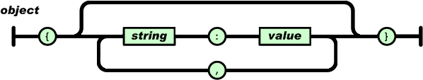
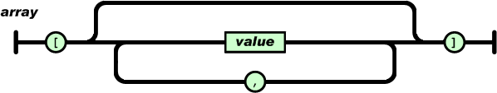
An object is an unordered set of name/value pairs.
An array is an ordered collection of values.

Slide 302
JSON
Returns data from a JSON document, selected from the parts of the document matched by the path arguments. Returns NULL if any argument is NULL or no paths locate a value in the document. An error occurs if the json_doc argument is not a valid JSON document or any path argument is not a valid path expression.
JSON_EXTRACT(json_doc, path[, path] ...)
SELECT ('[10, 20, [30, 40], [50, 60, 70]]');
SELECT JSON_EXTRACT('[10, 20, [30, 40], [50, 60, 70]]', '$[0]');
SELECT JSON_EXTRACT('[10, 20, [30, 40], [50, 60, 70]]', '$[3][0]');
SELECT JSON_EXTRACT('[10, 20, [30, 40]]', '$[0]', '$[1]');
SELECT ('{"id" : "1001", "ename" : "saleel"}');
SELECT ('[ {"id" : "1001“ ,"ename" : "saleel"}, {"id" : "1002", "ename" : "sharmin", "mob" : "12345"} ]');
SELECT JSON_EXTRACT('{"id" : "1001", "ename" : "saleel"}', '$.ename');

Slide 303
Datatype – JSON … (Insert)
MySQL supports a native JSON data type that enables efficient access to data in JSON (JavaScript Object Notation) documents.
CREATE table E (c1 json);
INSERT into E VALUES ('{}');
INSERT into E VALUES ('{"empno" : "1001", "ename" : "saleel", "phone" : [123,456]}');
INSERT into E VALUES ('{"empno" : "1002", "ename" : "sharmin" ,"phone" : [9922,8811], "address" : "Paud Road"}');
INSERT into E VALUES ('{"empno" : "1003", "ename" : "vrushali", "phone" : [7788,9977], "address" : {"city" : "Pune", "state" : "MH"}}');

Slide 304
Datatype – JSON … (Select)
MySQL supports a native JSON data type that enables efficient access to data in JSON (JavaScript Object Notation) documents.
CREATE table Books (data json);
SELECT * from Books;
SELECT json_extract (data, '$.*') FROM Books;
SELECT json_extract (data, '$.empno') FROM Books;
SELECT json_extract (data, '$.phone[1]') FROM Books;
SELECT json_extract (data, "$.address.city") FROM Books;

Slide 305
Use a CREATE TABLE statement to specify the layout of your table
CREATE TABLE
By default, tables are created in the default database, using the InnoDB storage engine. An error occurs if the table exists, if there is no default database, or if the database does not exist.

Slide 306
Create Table
CREATE [TEMPORARY] TABLE [IF NOT EXISTS] tbl_name
(create_definition,...)
[table_options]
[partition_options]
create_definition:
col_name column_definition
column_definition:
data_type [NOT NULL | NULL] [DEFAULT default_value]
[AUTO_INCREMENT] [UNIQUE [KEY] | [PRIMARY] KEY]
[COMMENT 'string']
[reference_definition]
| data_type [GENERATED ALWAYS] AS (expression)
[VIRTUAL] [UNIQUE [KEY]] [COMMENT comment]
[NOT NULL | NULL] [[PRIMARY] KEY]
table_options:
ENGINE [=] engine_name

Slide 307
Temporary Table
You can use the TEMPORARY keyword when creating a table.
A TEMPORARY table is visible only to the current session, and is dropped automatically when the session is closed.
Use TEMPORARY table with the same name as the original can be useful when you want to try some statements that modify the contents of the table, without changing the original table.
The permanent (original) table becomes hidden (inaccessible) to the client who creates the TEMPORARY table with same name as the original.
If you issue a DROP TABLE statement, the TEMPORARY table is removed and the original table reappears, it is possible, only when then original tbl_name and temporary tbl_name are same.
The original table also reappears if you rename the TEMPORARY table.

Slide 308
AUTO_INCREMENT
IDENTITY is a synonym to the LAST_INSERT_ID variable.
AUTO_INCREMENT applies only to integer and floating-point types.
There can be only one AUTO_INCREMENT column per table, it must be indexed, and it cannot have a DEFAULT value.
An AUTO_INCREMENT column works properly only if it contains positive values.
The AUTO_INCREMENT column must be indexed, which means it can be either PRIMARY KEY or UNIQUE index.
When you insert a value of NULL or 0 into AUTO_INCREMENT column, the column is set to the next sequence value.
Use LAST_INSERT_ID() function to find the row that contains the most recent AUTO_INCREMENT value
SELECT @@IDENTITY
SELECT LAST_INSERT_ID()
SET INSERT_ID = 7
There can be only one AUTO_INCREMENT column per table, it must be indexed, and it cannot have a DEFAULT value. An AUTO_INCREMENT column works properly only if it contains only positive values.

Slide 309
AUTO_INCREMENT
auto_increment_increment – is the incremental value, controls the interval between successive column values.
auto_increment_offset – determines the starting value for the AUTO_INCREMENT field; this value is used for the first record inserted into the table.
SET @@session.auto_increment_offset = 5
SET @@session.auto_increment_increment = 10
ALTER TABLE TEMP AUTO_INCREMENT = 0;

Slide 310
AUTO_INCREMENT
NO_AUTO_VALUE_ON_ZERO affects handling of AUTO_INCREMENT columns. Normally, you generate the next sequence number for the column by inserting either NULL or 0 into it. NO_AUTO_VALUE_ON_ZERO suppresses this behaviour for 0 so that only NULL generates the next sequence number.
SET sql_mode = '';
SET sql_mode = 'NO_AUTO_VALUE_ON_ZERO';

Slide 311
Virtual column - GENERATED ALWAYS
CREATE TABLE supports the specification of generated columns. Values of a generated column are computed from an expression included in the column definition.
col_name data_type [GENERATED ALWAYS] AS (expression) [VIRTUAL | STORED] [NOT NULL | NULL] [UNIQUE [KEY]] [[PRIMARY] KEY] [COMMENT 'string']
VIRTUAL: Column values are not stored, but are evaluated when rows are read, immediately after any BEFORE triggers. A virtual column takes no storage.
STORED: Column values are evaluated and stored when rows are inserted or updated. A stored column does require storage space and can be indexed.
Note: The default is VIRTUAL if neither keyword is specified.
CREATE TABLE triangle (
sidea DOUBLE,
sideb DOUBLE,
sidec DOUBLE AS (SQRT(sidea * sidea + sideb * sideb)) );

Slide 312
Virtual column - GENERATED ALWAYS
CREATE TABLE supports the specification of generated columns. Values of a generated column are computed from an expression included in the column definition.
col_name data_type [GENERATED ALWAYS] AS (expression) [VIRTUAL | STORED] [NOT NULL | NULL] [UNIQUE [KEY]] [[PRIMARY] KEY] [COMMENT 'string']
Triggers cannot use NEW.col_name or use OLD.col_name to refer to generated columns.
CREATE TABLE ... LIKE, the destination table preserves generated column information from the original table.
CREATE TABLE ... SELECT, the destination table does not preserves generated column information from the original table.

Slide 313
ALTER TABLE

Slide 314
Alter Table
ALTER TABLE changes the structure of a table. For example, you can add or delete columns, create or destroy indexes, change the type of existing columns, or rename columns or the table itself.
ALTER TABLE tbl_name [alter_specification [, alter_specification] ...]
| ADD [COLUMN] col_name column_definition [FIRST | AFTER col_name ]
| ADD [COLUMN] (col_name column_definition,...)
| ADD {INDEX|KEY} [index_name] (index_col_name,...)
| ADD [CONSTRAINT [symbol]] PRIMARY KEY
| ADD [CONSTRAINT [symbol]] UNIQUE KEY
| ADD [CONSTRAINT [symbol]] FOREIGN KEY reference_definition
| CHANGE [COLUMN] old_col_name new_col_name column_definition
[FIRST|AFTER col_name]
| MODIFY [COLUMN] col_name column_definition [FIRST | AFTER col_name]
| DROP [COLUMN] col_name
| DROP PRIMARY KEY
| DROP {INDEX|KEY} index_name
| DROP FOREIGN KEY fk_symbol
| RENAME [TO|AS] new_tbl_name

Slide 315
Alter Table
Change Columns :- You can rename a column using a CHANGE old_col_name new_col_name column_definition clause. To do so, specify the old and new column names and the definition that the column currently has.
Modify Columns :- You can also use MODIFY to change a column's type without renaming it.
Dropping Columns :- If a table contains only one column, the column cannot be dropped. If columns are dropped from a table, the columns are also removed from any index of which they are a part. If all columns that make up an index are dropped, the index is dropped as well.
To convert a table from one storage engine to another, use an ALTER TABLE statement that indicates the new engine:
ALTER TABLE tbl_name ENGINE = InnoDB
ALTER TABLE tbl_name ADD COL1 INT, ADD COL2 INT
ALTER TABLE tbl_name DROP COLUMN COL1, DROP COLUMN COL2
ALTER TABLE tbl_name DROP COLUMN C4, DROP COLUMN C5, ADD C3 INT

Slide 316
DROP TABLE
DROP and TRUNCATE are DDL commands, whereas DELETE is a DML command. Therefore DELETE operations can be rolled back (undone), while DROP and TRUNCATE operations cannot be rolled back.

Slide 317
Drop Table
DROP TABLE removes one or more tables. All table data and the table definition are removed.
DROP [TEMPORARY] TABLE [IF EXISTS] tbl_name [, tbl_name] ...

Slide 318
The TRUNCATE TABLE statement removes all the data of a table and resets the auto-increment value to zero.
TRUNCATE TABLE
DROP and TRUNCATE are DDL commands, whereas DELETE is a DML command. Therefore DELETE operations can be rolled back (undone), while DROP and TRUNCATE operations cannot be rolled back.

Slide 319
Truncate Table
Logically, TRUNCATE TABLE is similar to a DELETE statement that deletes all rows, or a sequence of DROP TABLE and CREATE TABLE statements.
TRUNCATE [TABLE] tbl_name
Truncate operations drop and re-create the table, which is much faster than deleting rows one by one.
Truncate operations cause an implicit commit, and so cannot be rolled back.
Truncate does not cause ON DELETE triggers to fire.
Truncate cannot be performed for InnoDB tables with parent-child foreign key relationships.
Truncate retain Identity and reset to the seed (start value) value.
Cannot truncate a table referenced in a foreign key constraint.

Slide 320
RENAME Table
RENAME TABLE old_tbl_name to new_tbl_name
RENAME TABLE EMP TO EMPLOYEE;

Slide 321
If more than one of the Key values applies to a given column of a table, Key displays the one with the highest priority, in the order PRI, UNI, and MUL.
Note that a table with a foreign key that references another table's primary key is MUL
CONSTRAINTS
PRI => primary key
UNI => unique key
MUL=> is basically an index that is neither a primary key nor a unique key. The name comes from "multiple" because multiple occurrences of the same value are allowed.

Slide 322
Constraints
MySQL CONSTRAINT is used to define rules to allow or restrict what values can be stored in columns. The purpose of inducing constraints is to enforce the integrity of a database.
MySQL CONSTRAINTS are used to limit the type of data that can be inserted into a table.
MySQL CONSTRAINTS can be classified into two types - column level and table level.
The column level constraints can apply only to one column where as table level constraints are applied to the entire table.

Slide 323
Keys in Relational Model (Candidate, Super, Primary, Alternate and Foreign)?
Candidate Key: The minimal set of attribute which can uniquely identify a tuple is known as candidate key. There can be more than one candidate key in a relation. For Example, ID as well as PHONE both are candidate keys for relation STUDENT.
Primary Key: There can be more than one candidate key in a relation out of which one can be chosen as primary key. For Example, ID as well as PHONE both are candidate keys for relation STUDENT but ID can be chosen as primary key (only one out of many candidate keys).
Alternate Key: The candidate key other than primary key is called as alternate key. For Example, ID as well as PHONE both are candidate keys for relation STUDENT but PHONE will be alternate key (only one out of many candidate keys).

Slide 324
A primary key cannot be NULL
A primary key value must be unique
The primary key values cannot be changed
The primary key must be given a value when a new record is inserted.
What is the meaning of PRIMARY KEY constraint?
If, we give on a column a combination of NOT NULL & UNIQUE key then it behaves like a PRIMARY key.

Slide 325
Constraints – Primary Key
A primary key is a column or a set of columns that uniquely identifies each row in the table.
A primary key must contain unique values. If the primary key consists of multiple columns, the combination of values in these columns must be unique.
A primary key column cannot contain NULL values. It means that you have to declare the primary key column with the NOT NULL attribute. If you don’t, MySQL will force the primary key column as NOT NULL implicitly.
A table has only one primary key.
data dictionary
information_schema.table_constraints;
information_schema.key_column_usage;
information_schema.referential_constraints
Primary key in a relation is always associated with an INDEX object

Slide 326
Constraints – Add Primary Key
The following example creates users table whose primary key is user_id column.
CREATE TABLE USERS (user_id INT PRIMARY KEY, username VARCHAR(40), password VARCHAR(255), email VARCHAR(255)) ENGINE=InnoDB;
You can also specify the PRIMARY KEY at the end of the CREATE TABLE statement as follows.
CREATE TABLE USERS (user_id INT, username VARCHAR(40), password VARCHAR(255), email VARCHAR(255), constraint pk_user_id PRIMARY KEY(USER_ID)) ENGINE=InnoDB;
In case the primary key consists of multiple columns, you must specify them at the end of the CREATE TABLE statement. You put a coma-separated list of primary key columns inside parentheses followed the PRIMARY KEY keywords.
CREATE TABLE USERS (user_id INT, username VARCHAR(40), password VARCHAR(255), email VARCHAR(255), constraint pk_user_id PRIMARY KEY(USER_ID, USERNAME)) ENGINE=InnoDB;

Slide 327
Constraints – Add Primary Key using Alter
You can use the ALTER TABLE statement to add Primary Key on existing column.
ALTER TABLE USERS ADD CONSTRAINT pk_user_id PRIMARY KEY (user_id)
data dictionary
information_schema.table_constraints;
information_schema.key_column_usage;
information_schema.referential_constraints

Slide 328
Constraints – Drop Primary Key
You can use the ALTER TABLE statement to drop Primary Key.
ALTER TABLE USERS DROP PRIMARY KEY;
data dictionary
information_schema.table_constraints;
information_schema.key_column_usage;
information_schema.referential_constraints

Slide 329
A composite key is a primary key composed of multiple columns used to identify a record uniquely.
What is Composite Key?
CREATE TABLE TEMP (
COL1 INT,
COL2 INT,
COL3 INT,
CONSTRAINT PK_COL1_COL2 PRIMARY KEY (COL1, COL2))

Slide 330
What is the meaning of
UNIQUE KEY constraint?

Slide 331
Constraints – Unique Key
The UNIQUE constraint uniquely identifies each record in a database table. The UNIQUE and PRIMARY KEY constraints both provide a guarantee for uniqueness for a column or set of columns.
data dictionary
information_schema.table_constraints;
information_schema.key_column_usage;
information_schema.referential_constraints

Slide 332
Constraints – Add Unique Key
The following example creates users table whose unique key is user_id column.
CREATE TABLE USERS (user_id INT UNIQUE KEY, username VARCHAR(40), password VARCHAR(255), email VARCHAR(255)) ENGINE=InnoDB;
You can also specify the UNIQUE KEY at the end of the CREATE TABLE statement as follows.
CREATE TABLE USERS (user_id INT, username VARCHAR(40), password VARCHAR(255), email VARCHAR(255), constraint u_user_id UNIQUE KEY (user_id) ENGINE=InnoDB);
In case the unique key consists of multiple columns, you must specify them at the end of the CREATE TABLE statement. You put a coma-separated list of unique key columns inside parentheses followed the UNIQUE KEY keywords.
CREATE TABLE USERS (user_id INT, username VARCHAR(40), password VARCHAR(255), email VARCHAR(255), constraint pk_user_id UNIQUE KEY(user_id, username) ENGINE=InnoDB);

Slide 333
Constraints – Add Unique Key using Alter
You can use the ALTER TABLE statement to add Unique Key on existing column.
ALTER TABLE USERS ADD constraint u_user_id UNIQUE KEY (user_id)
data dictionary
information_schema.table_constraints;
information_schema.key_column_usage;
information_schema.referential_constraints

Slide 334
Constraints – Drop Unique Key
You can use the ALTER TABLE statement to drop Unique Key.
ALTER TABLE USERS DROP INDEX <COLUMN_NAME>;
ALTER TABLE USERS DROP INDEX U_USER_ID; // CONSTRAINT NAME
data dictionary
information_schema.table_constraints;
information_schema.key_column_usage;
information_schema.referential_constraints

Slide 335
A foreign key can have a different name from its primary key.
DataType of primary key and foreign key column must be same.
It ensures rows in one table have corresponding rows in another.
Unlike the Primary key, they do not have to be unique.
Foreign keys can be null even though primary keys can not.
What is the meaning of
FOREIGN KEY constraint?
A FOREIGN KEY is a field (or collection of fields) in one table that refers to the PRIMARY KEY in another/same table.
The table containing the FOREIGN KEY is referred to as the child table, and the table containing the PRIMARY KEY (referenced key) is the parent table.

Slide 336
Constraints – Foreign Key
A referential constraint could be violated in following cases.
An INSERT attempt to add a row to a child table that has a value in its foreign key columns that does not match a value in the corresponding parent table's column.
An UPDATE attempt to change the value in a child table's foreign key columns to a value that has no matching value in the corresponding parent table's parent key.
An UPDATE attempt to change the value in a parent table's parent key to a value that does not have a matching value in a child table's foreign key columns.
A DELETE attempt to remove a record from a parent table that has a matching value in a child table's foreign key columns.

Slide 337
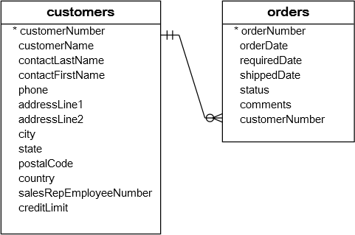
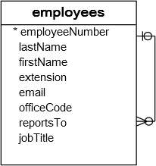
Constraints – Foreign Key
A foreign key is a field in a table that matches another field of another table. A foreign key places constraints on data in the related tables, which enables MySQL to maintain referential integrity.
The customers table is called parent table or referenced table, and the orders table is known as child table or referencing table.

Slide 338
Constraints – Foreign Key
A foreign key is a field in a table that matches another field of another table. A foreign key places constraints on data in the related tables, which enables MySQL to maintain referential integrity.
CREATE TABLE MODULE (id int ,subject varchar(1), description text, constraint pk_id_subject primary key(id, subject)) ENGINE=InnoDB;
CREATE TABLE STUDENT (id int , ModuleID int, subjectID varchar(1), address text, constraint fk_ModuleId_subjectID foreign key (ModuleID) references module(id)) ENGINE=InnoDB;
data dictionary
information_schema.table_constraints;
information_schema.key_column_usage;
information_schema.referential_constraints

Slide 339
Constraints – Foreign Key
A foreign key is a field in a table that matches another field of another table. A foreign key places constraints on data in the related tables, which enables MySQL to maintain referential integrity.
Cascaded FOREIGN KEY actions do not activate triggers.
[ON DELETE reference_option]
[ON UPDATE reference_option]
reference_option: RESTRICT | CASCADE | SET NULL | NO ACTION | SET DEFAULT
When an UPDATE or DELETE operation affects a key value in the parent table that has matching rows in the child table, the result depends on the referential action specified using ON UPDATE and ON DELETE sub clauses of the FOREIGN KEY clause.

Slide 340
Constraints – Foreign Key
CASCADE: Delete or update the row from the parent table, and automatically delete or update the matching rows in the child table. Both ON DELETE CASCADE and ON UPDATE CASCADE are supported.
SET NULL: Delete or update the row from the parent table, and set the foreign key column or columns in the child table to NULL. Both ON DELETE SET NULL and ON UPDATE SET NULL clauses are supported.
CREATE TABLE TEMP (id INT, fName varchar(10) , FOREIGN KEY (id) REFERENCES M(id) ON DELETE CASCADE) ENGINE=InnoDB;
CREATE TABLE TEMP (id INT, fName varchar(10), FOREIGN KEY (id) REFERENCES M(id) ON UPDATE CASCADE) ENGINE=InnoDB;
ALTER table E drop foreign key e_ibfk_1;
ON DELETE or ON UPDATE that is not specified, the default action is always RESTRICT.

Slide 341
What is the meaning of
Check Constraint?

Slide 342
Constraints – Check
Unfortunately, MySQL does not support CHECK constraint. Actually, MySQL accepts the CHECK clause in the CREATE TABLE statement but it ignores it silently.

Slide 343
Views

Slide 344
View
A VIEW is a logical representation of one or more tables. A VIEW contains no data itself. The tables upon which a VIEW is based are called base tables.
If a view is defined as SELECT * on a table, new columns added to the table later do not become part of the VIEW, and columns dropped from the table will result in an error when selecting from the VIEW.
A view must have unique column names with no duplicates, just like a base table. By default, the names of the columns retrieved by the SELECT statement are used for the VIEW column names.
The definition cannot refer to a TEMPORARY table, and you cannot create a TEMPORARY VIEW.
You cannot associate a TRIGGER with a VIEW.
If we drop the base table, the VIEW will not be dropped.

Slide 345
View
Views are not updatable in the following cases:
A table in the FROM clause is reference by a subquery in the WHERE statement.
There is a subquery in the SELECT clause.
The SQL statement defining the view joins tables.
One of the tables in the FROM clause is a non-updatable view.
The SELECT statement of the view contains an aggregate function such as SUM(), COUNT(), MAX(), MIN(), and so on.
The keywords DISTINCT, GROUP BY, HAVING, UNION, or UNION ALL appear in the defining SQL statement.

Slide 346
Create View
The select_statement is a SELECT statement that provides the definition of the view. The select_statement can select from base tables or other views.
CREATE [OR REPLACE]
VIEW view_name [(column_list)]
AS select_statement
[WITH CHECK OPTION]
UPDATE AND DELETE on VIEW (with check option given on view) will work only when the DATA MATCHES IN WHERE CLAUSE.
CREATE VIEW V1 as SELECT * from DEPT;
CREATE or REPLACE VIEW V1 as SELECT * from DEPT with CHECK OPTION;
desc INFORMATION_SCHEMA.VIEWS;

Slide 347
SHOW CREATE VIEW Syntax
SHOW CREATE VIEW view_name
show create view v1;
SHOW [FULL] TABLES [{FROM | IN} db_name]
[LIKE 'pattern' | WHERE expr]
show full tables where table_type like 'VIEW';

Slide 348
Alter / Drop View
This statement changes the definition of a view, which must exist.
ALTER VIEW view_name [(column_list)]
AS select_statement
[WITH CHECK OPTION]
DROP VIEW removes one or more views.
DROP VIEW [IF EXISTS]
view_name [, view_name] ...

Slide 349
MySQL indexes (PRIMARY KEY, UNIQUE, INDEX, and FULLTEXT) are stored in B-trees. FULLTEXT indexes are created on text-based columns (CHAR, VARCHAR, or TEXT columns) to help speed up queries and DML operations on data contained within those columns, omitting any words that are defined as stopwords.
Index

Slide 350
Index
Indexes are used to find rows with specific column values quickly. Without an index, MySQL must begin with the first row and then read through the entire table to find the relevant rows. If the table has an index for the columns in question, MySQL can quickly determine the position to seek to in the middle of the data file without having to look at all the data. This is much faster than reading every row sequentially.
To find the rows matching a WHERE clause quickly.
If the table has a multiple-column index, any leftmost prefix of the index can be used by the optimizer to look up rows. For example, if you have a three-column index on (col1, col2, col3), you have indexed search capabilities on (col1), (col1, col2), and (col1, col2, col3).
If we drop the base table, the INDEX will be dropped automatically.

Slide 351
Create Index
Indexes are used to find rows with specific column values quickly.
CREATE [UNIQUE] INDEX index_name
ON tbl_name (index_col_name,...)
CREATE INDEX IND1 ON EMP (ename)
CREATE UNIQUE INDEX IND1 ON EMP (ename)

Slide 352
SHOW INDEX Syntax
SHOW {INDEX | INDEXES | KEYS}
{FROM | IN} tbl_name
[{FROM | IN} db_name]
[WHERE expr]
SHOW INDEX FROM EMP;
SELECT table_name, index_name from INFORMATION_SCHEMA.STATISTICS;
SHOW INDEX returns table index information.

Slide 353
Drop Index
DROP INDEX drops the index named index_name from the table tbl_name.
DROP INDEX index_name ON tbl_name
DROP INDEX IND1 ON EMPLOYEE;

Slide 354
Lock / unlock table

Slide 355
lock / unlock
MySQL enables client sessions to acquire table locks to prevent from modifying tables
Sessions holding a READ lock, DROP TABLE and TRUNCATE TABLE operations are not permitted.
LOCK TABLES tbl_name lock_type [, tbl_name] lock_type] ...
lock_type:
READ |WRITE
UNLOCK TABLES
LOCK TABLE DEPT READ;
LOCK TABLE DEPT WRITE;
UNLOCK TABLE

Slide 356
DATA DICTIONARY

Slide 357
DATA DICTIONARY - INFORMATION_SCHEMA
INFORMATION_SCHEMA provides access to database metadata, information about the MySQL server such as the name of a database or table, the data type of a column, or access privileges.
INFORMATION_SCHEMA is a database within each MySQL instance, the place that stores information about all the other databases that the MySQL server maintains. The INFORMATION_SCHEMA database contains several read-only tables, you can only read the contents of tables, not perform INSERT, UPDATE, or DELETE operations on them, and you cannot set triggers on them.

Slide 358
DATA DICTIONARY - INFORMATION_SCHEMA
Data Dictionary
INFORMATION_SCHEMA.COLUMNS
INFORMATION_SCHEMA.TABLES
INFORMATION_SCHEMA.TABLE_CONSTRAINTS
INFORMATION_SCHEMA.STATISTICS
INFORMATION_SCHEMA.KEY_COLUMN_USAGE
INFORMATION_SCHEMA.ROUTINES
INFORMATION_SCHEMA.PARAMETERS
INFORMATION_SCHEMA.TRIGGERS

Slide 359
Class Room
Session 1

Slide 360
PL/SQL
PL/SQL is a procedural language extension to Structured Query Language (SQL). The purpose of PL/SQL is to combine database language and procedural programming language.

Slide 361
CREATE PROCEDURE and CREATE FUNCTION

Slide 362
Stored Procedure and Function
These statements create stored routines. By default, a routine is associated with the default database. To associate the routine explicitly with a given database, specify the name as db_name.sp_name when you create it.
desc mysql.proc
CREATE PROCEDURE sp_name ([proc_parameter[,...]])
proc_parameter:
[ IN | OUT | INOUT ] param_name type
CREATE FUNCTION sp_name ([func_parameter[,...]])
RETURNS type
SELECT * FROM information_schema.parameters
WHERE SPECIFIC_NAME = 'pro1';
DROP PROCEDURE IF EXISTS MyProcedure;
delimiter $$
CREATE PROCEDURE MyProcedure()
begin
SELECT 'Infoway Technologies, Pune';
end $$
delimiter ;

Slide 363
A parameter is a variable in a method definition. When a method is called, the arguments are the data you pass into the method's parameters. Parameter is variable in the declaration of function. Argument is the actual value of this variable that gets passed to function.
Difference between arguments and parameters?
Parameter is variable in the declaration of procedure or a function.
Argument is the actual value of this variable that gets passed to a procedure or a function.

Slide 364
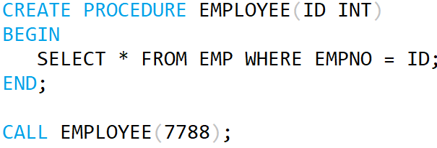
Stored Procedure and Function
Parameter List
Argument List

Slide 365
Difference between Stored Procedure and Function?

Slide 366
Stored Procedure and Function
A FUNCTION always returns a value using the return statement. PROCEDURE may return one or more values through OUT parameter(s) or may not return any at all.
Functions are normally used for computations where as procedures are normally used for executing business logic.
A Function returns 1 value only. Procedure can return multiple values (max 1024).
A function can be called directly by SQL statement like select func_name from dual while procedures cannot.
The major difference is that UDFs can be used like any other expression within SQL statements, whereas stored procedures must be invoked using the CALL statement.

Slide 367
Calling Procedure from Function and contrariwise
drop FUNCTION if exists F1;
delimiter $$
create FUNCTION F1() returns varchar(100)
begin
declare x varchar(100) default 'Hello World';
# select "Hello World";
call p1(x);
return x;
end$$
delimiter ;
drop PROCEDURE if exists P1;
delimiter $$
create PROCEDURE P1(out para1 varchar(100))
begin
# select "Hello World123";
select "Hello World123" into para1;
end$$
delimiter ;
// ERROR 1415 (0A000): Not allowed to
return a result set from a function
// ERROR 1415 (0A000): Not allowed to
return a result set from a function
This will work

Slide 368
SOURCE and CALL Stored Procedure

Slide 369
SOURCE and CALL Stored Procedure
If you are already running mysql, you can execute an SQL script file using the source command or \. command
source file_name.sql
\. file_name.sql
MySQL> source pl1.sql;
MySQL> \. file_name.sql;
The CALL statement invokes a stored procedure that was defined previously with CREATE PROCEDURE. Stored procedures that take no arguments can be invoked without parentheses. That is, CALL sp_name and CALL sp_name() are equivalent.
CALL sp_name([parameter[,...]])
CALL sp_name[()]
MySQL> call sp_name;
MySQL> call sp_name();

Slide 370
By default, mysql itself recognizes the semicolon as a statement delimiter, so you must redefine the delimiter temporarily to cause mysql to pass the entire stored program definition to the server. To redefine the mysql delimiter, use the delimiter command.
DELIMITER - Statement

Slide 371
A compound statement is a block that can contain other blocks; declarations for variables, condition handlers, and cursors; and flow control constructs such as loops and conditional tests.
BEGIN ... END Compound-Statement

Slide 372
BEGIN ... END
BEGIN ... END syntax is used for writing compound statements, which can appear within stored programs (stored procedures and functions, triggers, and events). A compound statement can contain multiple statements, enclosed by the BEGIN and END keywords. statement_list represents a list of one or more statements, each terminated by a semicolon (;) statement delimiter. The statement_list itself is optional, so the empty compound statement (BEGIN END) is legal.
[begin_label:] BEGIN
[statement_list]
END [end_label]

Slide 373
Declaring variables
DECLARE variable_name datatype(size) DEFAULT default_value;
Assigning variables
DECLARE is permitted only inside a BEGIN ... END compound statement and must be at its start, before any other statements.
1 2 | DECLARE z INT DEFAULT 0; SET z = 10;
DECLARE VARIABLES
First, you specify the variable name after the DECLARE keyword. The variable name must follow the naming rules of MySQL table column names.
Second, you specify the data type of the variable and its size. A variable can have any MySQL data types such as INT, VARCHAR , and DATETIME.
Third, when you declare a variable, its initial value is NULL. You can assign the variable a default value using the DEFAULT keyword.

Slide 374
Local Variable DECLARE and User-Defined Variables
Local variables are declared within stored procedures and are only valid within the BEGIN…END block where they are declared. Local variables can have any SQL data type.
DECLARE var_name [, var_name] ... type [DEFAULT value]
User variables in MySQL stored procedures, user variables are referenced with an ampersand (@) prefixed to the user variable name.
SET @var_name = expr [, @var_name = expr] ...
DROP PROCEDURE IF EXISTS MyProcedure;
delimiter $$
CREATE PROCEDURE MyProcedure()
beginLabel: begin
declare x varchar(12) default 'Infoway';
SELECT x;
end beginLabel $$
delimiter ;
DROP PROCEDURE IF EXISTS MyProcedure;
delimiter $$
CREATE PROCEDURE MyProcedure()
beginLabel: begin
set @x = 'Infoway';
SELECT @x;
end beginLabel $$
delimiter ;

Slide 375
Local Variable DECLARE
Local variables are declared within stored procedures and are only valid within the BEGIN…END block where they are declared. Local variables can have any SQL data type.
DECLARE var_name [, var_name] ... type [DEFAULT value]
drop procedure if exists procedureName;
delimiter $
create procedure procedureName()
begin
declare x varchar(20);
set x = 'Hello World;
SELECT x;
end$
delimiter ;

Slide 376
Local Variable DECLARE
drop procedure if exists pl1;
DELIMITER $$
CREATE PROCEDURE pl1()
BEGIN
DECLARE a INT DEFAULT 10;
DECLARE b, c INT;
SET a = a + 100;
SET b = 2;
SET c = a + b;
BEGIN
DECLARE c INT;
SET c = 5;
SELECT a, b, c;
END;
SELECT a, b, c;
END$$
DELIMITER ;

Slide 377
A procedure is a group of PL/SQL statements that you can call by name.
Stored Procedure
It is not permitted to assign the value DEFAULT to stored procedure or function parameters or stored program local variables (for example with a SET var_name = DEFAULT statement).

Slide 378
Stored Procedure - Examples
DROP PROCEDURE if EXISTS procedureName;
delimiter $$
CREATE PROCEDURE procedureName()
beginLabel: begin
SELECT * from EMP;
end beginLabel$$
delimiter ;
DROP PROCEDURE if EXISTS procedureName;
delimiter $$
CREATE PROCEDURE procedureName()
beginLabel: begin
declare x varchar(12);
SELECT ename into x from EMP where empno=7788;
SELECT x;
end beginLabel$$
delimiter ;

Slide 379
Stored Procedure - Examples
DROP PROCEDURE if EXISTS procedureName;
delimiter $$
CREATE PROCEDURE procedureName(in para1 int)
beginLabel: begin
declare x varchar(12);
SELECT ename into x from EMP where empno= para1;
SELECT x;
end beginLabel$$
delimiter ;
DROP PROCEDURE if EXISTS procedureName;
delimiter $$
CREATE PROCEDURE procedureName(in para1 varchar(15))
beginLabel: begin
declare x varchar(12);
SELECT job into x from EMP where ename= para1;
SELECT x;
end beginLabel$$
delimiter ;

Slide 380
Stored Procedure - Examples
DROP PROCEDURE procedureName;
delimiter $$
CREATE PROCEDURE procedureName(para1 varchar(12))
beginLabel: begin
SELECT * from EMP where job=para1;
end beginLabel $$
delimiter ;
DROP PROCEDURE procedureName;
delimiter $$
CREATE PROCEDURE procedureName(para1 varchar(12), out s int, out j varchar(12))
beginLabel: begin
SELECT para1, sum(Sal) into varJob, varSumSal from EMP where job=para1;
end beginLabel $$
delimiter ;

Slide 381
Stored Procedure - Examples
DROP PROCEDURE procedureName;
delimiter $$
CREATE PROCEDURE procedureName(in p1 int(2), in p2 varchar(12), in p3 varchar(10), in p4 varchar(20))
beginLabel: begin
INSERT into DEPT values (p1, p2, p3, p4);
end beginLabel $$
delimiter ;
DROP PROCEDURE procedureName;
delimiter $$
CREATE PROCEDURE MyProcedure (inout p1 int(2))
beginLabel: begin
set p1 = p1+2;
end beginLabel $$
delimiter ;
mysql> SET @x = 10
mysql> CALL procudeureName(@x);
mysql> SELECT @x

Slide 382
Stored Procedure - Examples
drop procedure if exists procedureName;
delimiter $
CREATE procedure procedureName()
begin
CREATE table TEMP (col1 int);
end$
delimiter ;
drop procedure if exists procedureName;
delimiter $
create procedure procedureName(v1 int, v2 varchar(20), v3 varchar(20), v4 varchar(20))
begin
INSERT into DEPT values (v1, v2, v3, v4);
end$
delimiter ;
drop procedure if exists pro1;
delimiter $
CREATE PROCEDURE pro1(IN var1 INT)
BEGIN
SELECT * FROM emp LIMIT var1;
END$
delimiter ;

Slide 383
Stored Procedure - Examples
drop procedure if exists procedureName;
delimiter $
create procedure procedureName()
begin
create table TEMP (col1 int);
end$
delimiter ;
drop procedure if exists procedureName;
delimiter $
create procedure procedureName(in x int, in y int, out z int, out z1 int )
begin
SET z = x + y;
SET z1 = x * y;
end$
delimiter ;
-----------------------------------------------------------------------------------------------
mysql> SET @a := 0;
mysql> SET @b := 0;
mysql> CALL pro1(5, 4, @a, @b);

Slide 384
DELIMITER PROBLEM
drop procedure if exists p1;
delimiter $$
CREATE PROCEDURE p1(out para1 varchar(100))
begin
select "Hello World123 into para1;
end$$
delimiter ;

Slide 385
IF and LOOP Label

Slide 386
IF and LOOP
IF search_condition THEN statement_list
[ELSEIF search_condition THEN statement_list] ...
[ELSE statement_list]
END IF
ITERATE means "start the loop again."
LEAVE statement is used to exit the flow control construct that has the given label.
[begin_label:] LOOP
statement_list
END LOOP [end_label]
ITERATE label
LEAVE label

Slide 387
IF and LOOP - Example
DROP PROCEDURE if EXISTS procedureName;
delimiter $$
CREATE PROCEDURE procedureName()
beginLabel: begin
declare x int;
set x:= 100;
loopLabel: loop
IF x<=110 then
set x := x + 1;
SELECT x;
ITERATE loopLabel;
ELSE
LEAVE loopLabel;
END IF;
end loop loopLabel;
end beginLabel$$
delimiter ;

Slide 388
CURSOR
Cursor declarations must appear before handler declarations. Variable and condition declarations must appear before cursor or handler declarations.

Slide 389
Cursor
This statement declares a cursor and associates it with a SELECT statement that retrieves the rows to be traversed by the cursor.
DECLARE cursor_name CURSOR FOR select_statement
This statement opens a previously declared cursor.
OPEN cursor_name
This statement fetches the next row for the SELECT statement associated with the specified cursor (which must be open), and advances the cursor pointer. If a row exists, the fetched columns are stored in the named variables. The number of columns retrieved by the SELECT statement must match the number of output variables specified in the FETCH statement.
FETCH [[NEXT] FROM] cursor_name INTO var_name [, var_name] ...
If no more rows are available, a No Data condition.
This statement closes a previously opened cursor.
CLOSE cursor_name

Slide 390
Cursor
DROP PROCEDURE if EXISTS procedureName;
delimiter $$
CREATE PROCEDURE procedureName para1 varchar(25))
beginLabel: begin
declare done TINYINT DEFAULT FALSE;
declare varEMPNO int;
declare varENAME varchar(20);
declare c1 cursor for SELECT empno, ename from EMP where job = para1;
declare exit handler for NOT FOUND set done=true;
OPEN c1;
loopLabel: loop
FETCH c1 into varEMPNO, varENAME;
IF done then
leave loopLabel;
ELSE
select varEMPNO as "Employee No.", varENAME as "Employee Name";
END IF;
end loop loopLabel;
CLOSE c1;
end beginLabel$$
delimiter ;

Slide 391
EXCEPTION / SIGNAL

Slide 392
Exception / Signal
DROP PROCEDURE IF EXISTS procedureName;
delimiter $
CREATE PROCEDURE procedureName()
begin
DECLARE a INT DEFAULT 101;
DECLARE myException CONDITION FOR SQLSTATE '45000';
/* DECLARE EXIT HANDLER FOR 1146 SELECT 'table not found';
DECLARE EXIT HANDLER FOR 1064
*/
IF a = 10 then
SELECT 'ok';
ELSE
SIGNAL myException
SET MESSAGE_TEXT = 'bad';
END IF;
end $
delimiter ;

Slide 393
First, you specify the name of the stored function after CREATE FUNCTION clause. Second, you list all parameters of the stored function inside the parentheses.
By default, all parameters are IN parameters. You cannot specify IN , OUT or INOUT modifiers to the parameters.
FUNCTIONS
The RETURNS clause may be specified only for a FUNCTION, for which it is mandatory. It indicates the return type of the function, and the function body must contain a RETURN value statement.
Note: ERROR 1415 (0A000): Not allowed to return a result set from a function
SELECT "Hello World"; // will not work in FUNCTION
SELECT "Hello World" into x; // will work in FUNCTION

Slide 394
User Defined Function - Examples
DROP FUNCTION functionName;
delimiter $$
CREATE FUNCTION functionName() RETURNS int
beginLabel: begin
declare x int;
set x = 1001;
return (x);
end beginLabel $$
delimiter ;
DROP FUNCTION functionName;
delimiter $$
CREATE FUNCTION functionName(para1 varchar(12)) RETURNS int
beginLabel: begin
declare total int default 0;
SELECT sum(sal) into total from EMP where job=para1;
return (total);
end beginLabel $$
delimiter ;

Slide 395
User Defined Function - Examples
drop function if exists functionName;
delimiter $
create function functionName() returns int
begin
declare x int;
select max(deptno) + 1 into x from dept;
return(x);
end$
delimiter ;

Slide 396
User Defined Function - Examples
drop function if exists functionName;
delimiter $
create function functionName(no int) returns varchar(20)
begin
declare x varchar(20);
select distinct 'Number present' into x from t1 where c1 = no;
if x is not null then
return(x);
else
return (no);
end if;
end$
delimiter ;

Slide 397
A trigger or database trigger is a stored program executed automatically to respond to a specific event e.g., INSERT, UPDATE or DELETE occurred in a table. The database trigger is powerful tool for protecting the integrity of the data in MySQL databases.
TRIGGERS
The trigger is always associated with the table named tbl_name, which must refer to a permanent table. You cannot associate a trigger with a TEMPORARY table or a VIEW. If you drop a table, any triggers for the table are also dropped.

Slide 398
TRIGGER
The trigger is always associated with the table named tbl_name, which must refer to a permanent table. You cannot associate a trigger with a TEMPORARY table or a VIEW.
CREATE TRIGGER trigger_name
trigger_time trigger_event
ON tbl_name FOR EACH ROW
trigger_body
trigger_time: { BEFORE | AFTER }
trigger_event: { INSERT | UPDATE | DELETE }
SHOW CREATE TRIGGER trigger_name
DESC INFORMATION_SCHEMA.TRIGGERS

Slide 399
TRIGGER
You put the trigger name after the CREATE TRIGGER statement. The trigger name should follow the naming convention [trigger time]_[table name]_[trigger event], for example before_employees_update.
Trigger activation time can be BEFORE or AFTER. You must specify the activation time when you define a trigger. You use the BEFORE keyword if you want to process action prior to the change is made on the table and AFTER if you need to process action after the change is made.
The trigger event can be INSERT, UPDATE or DELETE. This event causes the trigger to be invoked. A trigger only can be invoked by one event. To define a trigger that is invoked by multiple events, you have to define multiple triggers, one for each event.
A trigger must be associated with a specific table. Without a table trigger would not exist therefore you have to specify the table name after the ON keyword.
You place the SQL statements between BEGIN and END block. This is where you define the logic for the trigger.

Slide 400
What is trigger_time and trigger_event ?
trigger_time : trigger_time is the trigger action time. It can be BEFORE or AFTER to indicate that the trigger activates before or after each row to be modified.
trigger_event : trigger_event indicates the kind of operation that activates the trigger.
INSERT: The trigger activates whenever a new row is inserted into the table; for example, through INSERT, LOAD DATA, and REPLACE statements.
UPDATE: The trigger activates whenever a row is modified; for example, through UPDATE statements.
DELETE: The trigger activates whenever a row is deleted from the table; for example, through DELETE and REPLACE statements. DROP TABLE and TRUNCATE TABLE statements on the table do not activate this trigger, because they do not use DELETE. Dropping a partition does not activate DELETE triggers, either.

Slide 401
BEFORE and AFTER
If a BEFORE trigger fails, the operation on the corresponding row is not performed.
A BEFORE trigger is activated by the attempt to insert or modify the row or delete the row, regardless of whether the attempt subsequently succeeds.
An AFTER trigger is executed only if any BEFORE triggers and the row operation execute successfully.
An error during either a BEFORE or AFTER trigger results in failure of the entire statement that caused trigger invocation.

Slide 402
NEW and OLD
The OLD and NEW keywords enable you to access columns in the rows affected by a trigger. OLD and NEW are MySQL extensions to triggers; they are not case sensitive.
A column named with OLD is read only. In a BEFORE trigger, you can also change its value with SET NEW.col_name = value.
In an INSERT trigger, only NEW.col_name can be used; there is no OLD row.
In a DELETE trigger, only OLD.col_name can be used; there is no NEW row.
In an UPDATE trigger, you can use OLD.col_name to refer to the columns of a row before it is updated and NEW.col_name to refer to the columns of the row after it is updated.
The trigger occurs. This can either be BEFORE or AFTER an INSERT, UPDATE or DELETE. A BEFORE trigger must be used if you need to modify incoming data. An AFTER trigger must be used if you want to reference the new/changed record as a foreign key for a record in another table.
A column named with OLD is read only.

Slide 403
NOTE
The trigger cannot use the CALL statement to invoke stored procedures that return data to the client or that use dynamic SQL. (Stored procedures are permitted to return data to the trigger through OUT or INOUT parameters.)

Slide 404
DROP TRIGGER
This statement drops a trigger. The schema (database) name is optional. If the schema is omitted, the trigger is dropped from the default schema.
DROP TRIGGER [IF EXISTS] [schema_name.]trigger_name
If you drop a table, any triggers for the table are also dropped.
As of MySQL 5.7.2, it is possible to define multiple triggers for a given table that have the same trigger event and action time. For example, you can have two BEFORE UPDATE triggers for a table. By default, triggers that have the same trigger event and action time activate in the order they were created.

Slide 405
Example of trigger
drop trigger if exists triggerName;
delimiter $
create trigger triggerName before insert on dept for each row
begin
select 'Hello World';
end$
delimiter ;
ERROR 1415 (0A000): Not allowed to return a result set from a trigger

Slide 406
Example of trigger
drop trigger if exists triggerName;
delimiter $
CREATE trigger triggerName after INSERT on dept for each row
BEGIN
insert into d1 values (new.deptno, new.dname, new.loc, new.pwd);
END $
delimiter ;
drop trigger if exists triggerName;
delimiter $
CREATE trigger triggerName after UPDATE on dept for each row
BEGIN
insert into d1 values (old.dname, new.dname);
END $
delimiter ;
drop trigger if exists triggerName;
delimiter $
CREATE trigger triggerName after DELETE on dept for each row
BEGIN
insert into d values (old.deptno, old.dname, old.loc, old.pwd, now(), user());
END $
delimiter ;

Slide 407
Example of trigger
drop trigger if exists triggerName;
delimiter $
CREATE trigger triggerName after INSERT on dept for each row
BEGIN
insert into d values (new.deptno, new.dname, new.loc, new.pwd, now(), user());
END $
delimiter ;
drop trigger if exists triggerName;
delimiter $
CREATE trigger triggerName after INSERT on dept for each row
BEGIN
if DATE_FORMAT (now(), '%W') = 'Wednesday' then
signal sqlstate '42000' set message_text = 'Invalid';
end if;
END $
delimiter ;

Slide 408
Example of trigger
drop trigger if exists triggerName;
delimiter $
CREATE TRIGGER triggerName before INSERT on DEPT for each row
begin
declare msg varchar(100);
if new.dname = 'A' then
set new.dname = 'Apple';
else
set msg = 'My error message';
signal sqlstate '42000' set message_text = msg;
end if;
end $
delimiter ;

Slide 409
Example of trigger
drop trigger if exists triggerName;
delimiter $
CREATE trigger triggerName before INSERT on dept for each row
BEGIN
if new.deptno < 50 then
signal sqlstate '42000' set message_text = ‘Invalid department number';
end if;
END $
delimiter ;
drop trigger if exists triggerName;
delimiter $
CREATE TRIGGER triggerName before INSERT on EMP for each row
begin
if new.sal <=0 then
set new.sal = 25000;
end if;
end $
delimiter ;
ERROR 1362 (HY000): Updating of NEW row is not allowed in after trigger
mysql> insert into emp (empno, ename, sal, mgr, deptno) values(1, ‘ abc', -10000, 7788, 10);

Slide 410
Example of trigger
drop trigger if exists triggerName;
delimiter $
CREATE TRIGGER triggerName before INSERT on city for each row
begin
declare msg varchar(100);
if new.c1 <> 'Pune' then
set msg = 'Invalid city name';
signal sqlstate '42000' set message_text = msg;
end if;
end $
delimiter ;

Slide 411
Example of trigger
drop trigger if exists triggerName;
delimiter $
CREATE TRIGGER triggerName before INSERT on dept for
each row
begin
set new.dname = upper(new.dname);
end $
delimiter ;
mysql> insert into dept values(2, 'abc', 2, 2);

Slide 412
Example of trigger
drop trigger if exists triggerName;
delimiter $
CREATE trigger triggerName before INSERT on emp for each row
BEGIN
declare x int;
set x = (SELECT deptno from DEPT where deptno=new.deptno);
if x is null then
signal sqlstate '42000' set message_text = 'error';
end if;
END $
delimiter ;
drop trigger if exists triggerName;
delimiter $
CREATE trigger triggerName before INSERT on dept for each row
BEGIN
declare x int;
set x = (select max(deptno) + 1 from dept);
set new.deptno = x;
END $
delimiter ;

Slide 413
Database normalization, or simply normalization, is the process of organizing the columns (attributes) and tables (relations) of a relational database to reduce data redundancy and improve data integrity.
NORMALIZATION

Slide 414
STUDENT INFORMATION SYSTEM
A PROJECT ON
STUDENT MANAGEMENT SYSTEM
1st NF
Student Table
ID (PK)
TITLE
FIRSTNAME
MIDDLENAME
LASTNAME
GENDER
DOB
MATERIALSTATUS
NATIONALITY
ADDRESS
COUNTRY
STATE
DISTRICT
CITY
ZIP
LANDLINE
MOBILE
EMAILID
QUALIFICATION
HOBBIES
ACHIVEMENTS

Slide 415
STUDENT INFORMATION SYSTEM
A PROJECT ON
STUDENT MANAGEMENT SYSTEM
2nd NF
STUDENT | TITLE | GENDER | MATERIAL STATUS | NATIONALITY
ID (PK) | ID (PK) | ID (PK) | ID (PK) | ID (PK)
TITLEID (FK) | NAME | NAME | NAME | NAME
FIRSTNAME
MIDDLENAME | COUNTRY | STATE | DISTRICT | CITY | CONTACT
LASTNAME | ID (PK) | ID (PK) | ID (PK) | ID (PK) | STUDENTID(PK & FK)
GENDERID (FK) | NAME | NAME | NAME | NAME | LANDLINE
DOB |  |  |  |  | MOBILE
MATERIALSTATUSID (FK) |  |  |  |  | EMAILID
NATIONALITYID (FK)
ADDRESS | QUALIFICATION | HOBBIES | ACHIVEMENTS
STUDENTID(PK & FK) | ID (PK) | ID (PK) | ID (PK)
LINE#1 | STUDENTID(FK) | STUDENTID(FK) | STUDENTID(FK)
LINE#2 | NAME | NAME | NAME
COUNTRYID (FK) | ADDMISSIONYEAR
STATEID (FK) | INSTITUTE
DISTRICTID (FK) | UNIVERSITY
CITYID (FK) | YEAROFPASSING
ZIP | PERCENTAGE
 | GRADE

Slide 416
STUDENT INFORMATION SYSTEM
A PROJECT ON
STUDENT MANAGEMENT SYSTEM
3rd NF
STUDENT | TITLE | GENDER | MATERIAL STATUS | NATIONALITY
ID (PK) | ID (PK) | ID (PK) | ID (PK) | ID (PK)
TITLEID (FK) | NAME | NAME | NAME | NAME
FIRSTNAME
MIDDLENAME | COUNTRY | STATE | DISTRICT | CITY | CONTACT
LASTNAME | ID (PK) | ID (PK) | ID (PK) | ID (PK) | STUDENTID(PK & FK)
GENDERID (FK) | NAME | COUNTRYID (FK) | STATEID (FK) | DISTRICTID (FK) | LANDLINE
DOB |  | NAME | NAME | NAME | MOBILE
MATERIALSTATUSID (FK) |  |  |  |  | EMAILID
NATIONALITYID (FK)
ADDRESS | QUALIFICATION | HOBBIES | ACHIVEMENTS
STUDENTID(PK & FK) | ID (PK) | ID (PK) | ID (PK)
LINE#1 | STUDENTID(FK) | STUDENTID(FK) | STUDENTID(FK)
LINE#2 | NAME | NAME | NAME
CITYID (FK) | ADDMISSIONYEAR
ZIP | INSTITUTE
 | UNIVERSITY
 | YEAROFPASSING
 | PERCENTAGE
 | GRADE

Slide 417
TOUR & TRAVEL MANAGEMENT
A PROJECT ON
TOUR & TRAVEL MANAGEMENT
Modules that will be there in the projects are :
CUSTOMERS
TRAVELER
ADMIN
VISITOR

Slide 418
User Specification
Admin:- Admin can manage the user and receive package from traveller.
Traveller:- Traveller create the package and give to admin.
Customer:- Customer can view package and booking.
Visitor:- Visitor view side and give feedback.

Slide 419
User Specification
CUSTOMER
Registration (Login)
View package
Search package
Booking
Give Payment
Booking Cancellation
Give Feedback
TRAVELER
Registration (Login)
Manage tour
Manage tour package cost
Manage Bus (travels)
ADMIN
Registration (Login)
Manage User
Manage Tour-package
Manage Ticket Booking
Manage Payment
View Cancellation
View feedback
VISITOR
View site
Give feedback

Slide 420
TOUR & TRAVEL MANAGEMENT
A PROJECT ON
TOUR & TRAVEL MANAGEMENT
1st NF
TOURE
ID (PK)
NAME
TYPE
SUBTYPE
CHILDSUBTYPE
COUNTRY
SPOTS
DURATION
STARTON (DateTime)
ENDON (DateTime)
COST
FACILITY
INCLUDED
EXCLUDED
SCHEDULEDON
PORPOSE (BUSINESS, EXIBATION, MEETING)
DESCRIPTION
ITINERARY
NOTES
EXTRATOPPING
OURSPECIALITY
REPORTING AND DROPPING
TRANSPORT
HOTEL
HIGHLIGHT
POINTS
DETAILS

Slide 421
TOUR & TRAVEL MANAGEMENT
A PROJECT ON TOUR & TRAVEL MANAGEMENT
2nd NF
TOUR |  | TYPE |  | SUBTYPE |  | CHILDSUBTYPE
ID (PK) |  | ID (PK) |  | ID (PK) |  | ID (PK)
NAME |  | NAME |  | NAME |  | NAME
DURATION
DESCRIPTION
COUNTRY |  | SPOTS |  | SCHEDULE |  | FACILITY
ID (PK) |  | ID (PK) |  | ID (PK) |  | ID (PK)
NAME |  | ITINERARYID (FK) |  | TOUREID (FK) |  | TOUREID (FK)
 |  | NAME |  | STARTON (DateTime) |  | NAME
 |  |  |  | ENDON (DateTime)
 |  |  |  | COST
INCLUDED |  | EXCLUDED |  | PURPOSE
ID (PK) |  | ID (PK) |  | ID (PK)
TOUREID (FK) |  | TOUREID (FK) |  | TOUREID (FK)
NAME |  | NAME |  | NAME
ITINERARY |  | DAYWISE SCHEDULE |  | NOTES |  | EXTRATOPPING
ID (PK) |  | ID (PK) |  | ID (PK) |  | ID (PK)
TOUREID (FK) |  | ITINERARYID (FK) |  | ITINERARYID (FK) |  | ITINERARYID (FK)
VALIDFROM |  | HEADING |  | NOTES |  | EXTRATOPPINGS
VALIDTO |  | DESCRIPTION
 |  | BREAKFAST |  | OURSPECIALITY |  | REPORTING AND DROPPING
 |  | LUNCH |  | ID (PK) |  | ID (PK)
 |  | HITEA |  | ITINERARYID (FK) |  | ITINERARYID (FK)
 |  | DINNER |  | SPECIALITIES |  | DETAILS
 |  | EXTRATOPPING
TRANSPORT |  | HOTEL |  | POINTS
ID (PK) |  | ID (PK) |  | ID (PK)
TOUREID (FK) |  | TOUREID (FK) |  | SPOTID {FK}
TYPE |  | NAME |  | NAME
DESCRIPTION |  | TYPE |  | DETAILS
 |  | DESCRIPTION

Slide 422
TOUR & TRAVEL MANAGEMENT
A PROJECT ON TOUR & TRAVEL MANAGEMENT
3rd NF
TOUR |  | TYPE |  | SUBTYPE |  | CHILDSUBTYPE
ID (PK) |  | ID (PK) |  | ID (PK) |  | ID (PK)
NAME |  | NAME |  | TYPEID (FK) |  | SUBTYPEID (FK)
DURATION |  |  |  | NAME |  | NAME
DESCRIPTION
CHILDSUBTYPEID(FK)
COUNTRY |  | SPOTS |  | SCHEDULE |  | FACILITY
ID (PK) |  | ID (PK) |  | ID (PK) |  | ID (PK)
NAME |  | ITINERARYID (FK) |  | TOUREID (FK) |  | TOUREID (FK)
 |  | NAME |  | STARTON (DateTime) |  | NAME
 |  |  |  | ENDON (DateTime)
 |  |  |  | COST
INCLUDED |  | EXCLUDED |  | PURPOSE
ID (PK) |  | ID (PK) |  | ID (PK)
TOUREID (FK) |  | TOUREID (FK) |  | TOUREID (FK)
NAME |  | NAME |  | NAME
ITINERARY |  | DAYWISE SCHEDULE |  | NOTES |  | EXTRATOPPING
ID (PK) |  | ID (PK) |  | ID (PK) |  | ID (PK)
COUNTRYID(FK) |  | ITINERARYID (FK) |  | ITINERARYID (FK) |  | ITINERARYID (FK)
TOUREID (FK) |  | HEADING |  | NOTES |  | EXTRATOPPINGS
VALIDFROM |  | DESCRIPTION
VALIDTO |  | BREAKFAST |  | OURSPECIALITY |  | REPORTING AND DROPPING
 |  | LUNCH |  | ID (PK) |  | ID (PK)
 |  | HITEA |  | ITINERARYID (FK) |  | ITINERARYID (FK)
 |  | DINNER |  | SPECIALITIES |  | DETAILS
 |  | EXTRATOPPING
TRANSPORT |  | HOTEL |  | POINTS
ID (PK) |  | ID (PK) |  | ID (PK)
TOUREID (FK) |  | TOUREID (FK) |  | SPOTID {FK}
TYPE |  | NAME |  | NAME
DESCRIPTION |  | TYPE |  | DETAILS
 |  | DESCRIPTION

Slide 423
Big Data?
Big data is a term that describes the large volume of data – both structured and unstructured

Slide 424
IMP SQL statements
1. Find 2nd highest salary.
SELECT MAX(SAL) FROM EMP WHERE SAL < (SELECT MAX(SAL) FROM EMP);
2. Find 2nd lowest salary.
SELECT MIN(SAL) FROM EMP WHERE SAL > (SELECT MIN(SAL) FROM EMP);
3. Find 2nd highest salary of each department.
SELECT MAX(SAL) FROM EMP WHERE SAL NOT IN (SELECT MAX(SAL) FROM EMP GROUP BY DEPTNO) GROUP BY DEPTNO;
4. Find 2nd lowest salary of each department.
SELECT MIN(SAL) FROM EMP WHERE SAL NOT IN (SELECT MIN(SAL) FROM EMP GROUP BY DEPTNO) GROUP BY DEPTNO;
select count(*), e.* from e group by empno, ename, job, mgr, hiredate, sal, comm, deptno, bonusid, `user name`, pwd;

Slide 425
Interview questions

Slide 426
IMP SQL statements
TABLET Table
Id | Name | Ingredient | Unit
1 | CROCIN | PARACETAMOL | 100mg
2 | COMBIFLAM | PARACETAMOL, IBUPROFEN | 25mg
3 | DIVON PLUS | PARACETAMOL, DICLOFENAC | 30mg
SYRUP Table
Id | Name | Ingredient | Unit
11 | BENADRYL | DIPHENHYDRAMINE | .7mg
12 | COMBIFLAM | PARACETAMOL, IBUPROFEN | 0.12mg
13 | COREX | CHLORPHENAMINE | 2.3mg
14 | DICLO | DICLOFENAC | 0.06mg
INJECTION Table
Id | Name | Ingredient | Unit
21 | BRUFEN | IBUPROFEN | 0.10mg
22 | CPM | CHLORPHENAMINE | 0.25mg
23 | VOVERAN | DICLOFENAC | 0.09mg

Slide 427
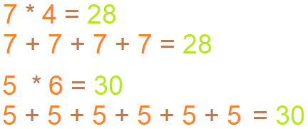
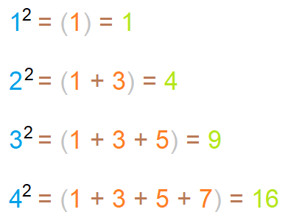
IMP
1. Think about how multiplication can be done without actually multiplying
2. Square

Slide 428

"Live as if you were to die tomorrow.
Learn as if you were to live forever"

